Slide 1
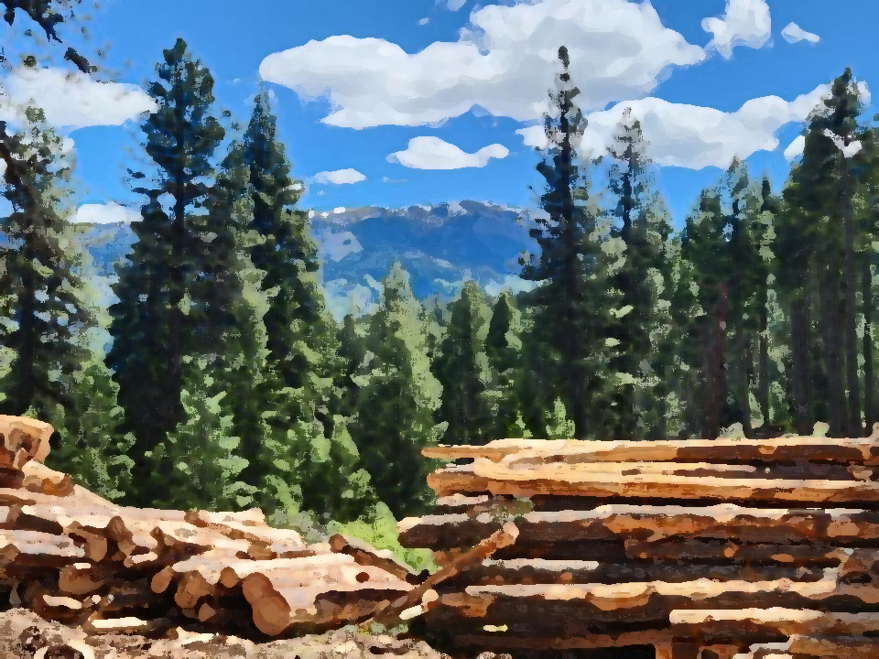
2024 Forest Practices Audit
Hawk Stone
Water Quality Scientist
Idaho DEQ
Notes:
Where is NIPF better than the rest? Variances. Maintenance debris. SPZ harvest. Maintaining skid trails. Siting skid trails in stable locations.
Worse? Installing culverts and ditches (tend to skip them). Minimizing fill erosion. Maintaining bridges and culverts. Repairing erosion sources to streams. Using equipment and piling slash in the SPZ.

Slide 2
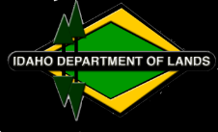
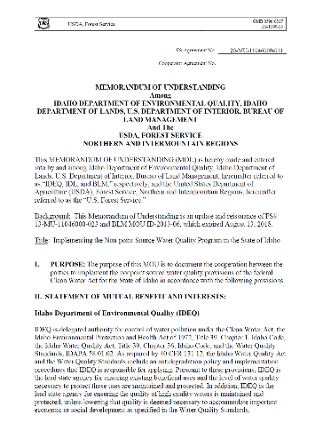
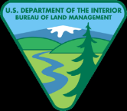
2020 Memorandum of Understanding

Slide 3
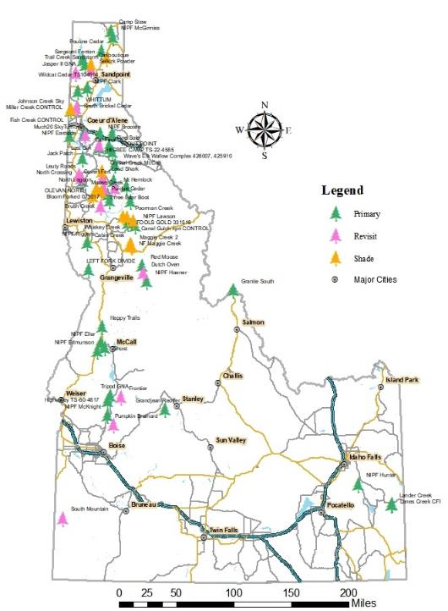
58 Audit Sites
Site Requirements
Harvested in last 2 years
Contain a fish-bearing stream
At least 5 acres
All ownerships
Notes:
Divided between ownerships
58 sites: 19 industrial private, 14 state, 14 federal, 11 non-industrial private
Stratified Randomly selected – spread across ownership, state and IDL admin area
Not surprise

Slide 4
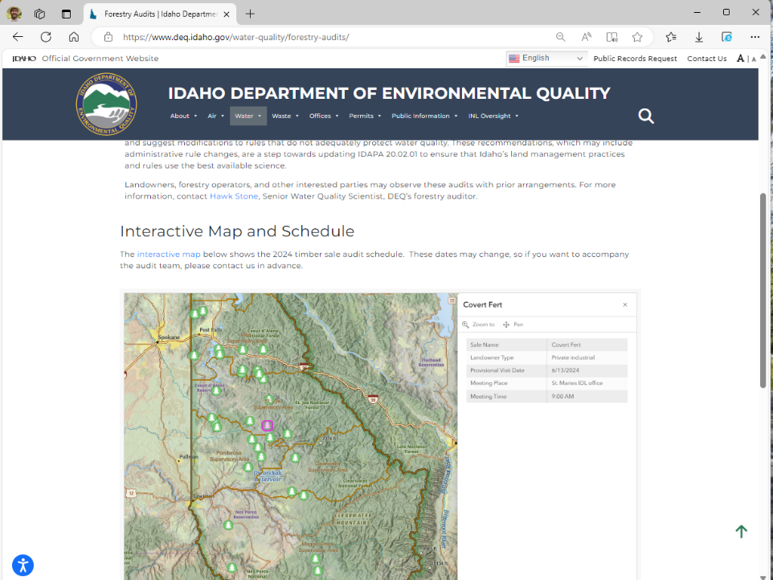
Website

Slide 5
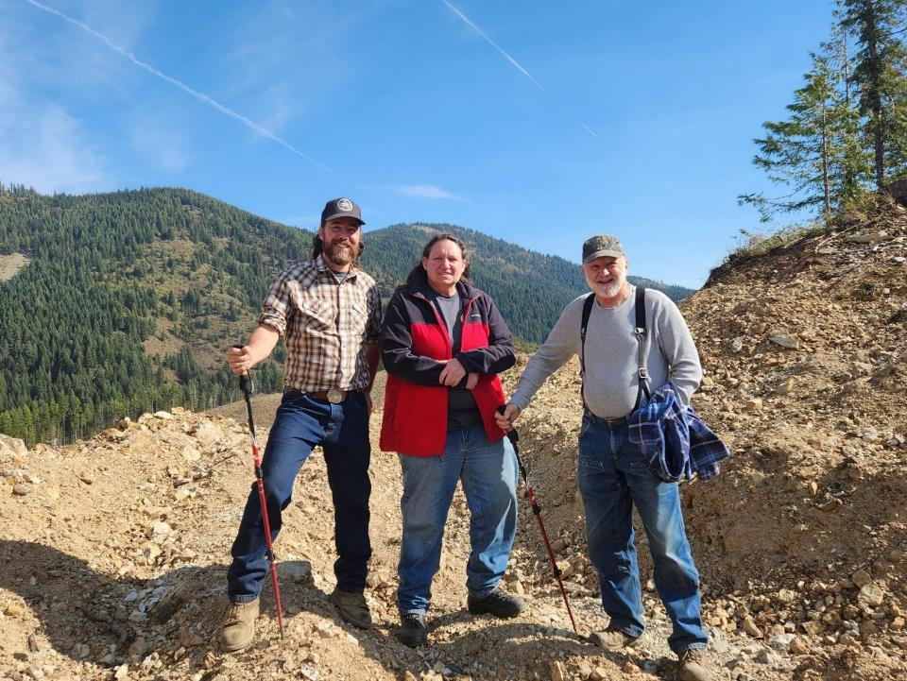
Meet the new audit team

Slide 6
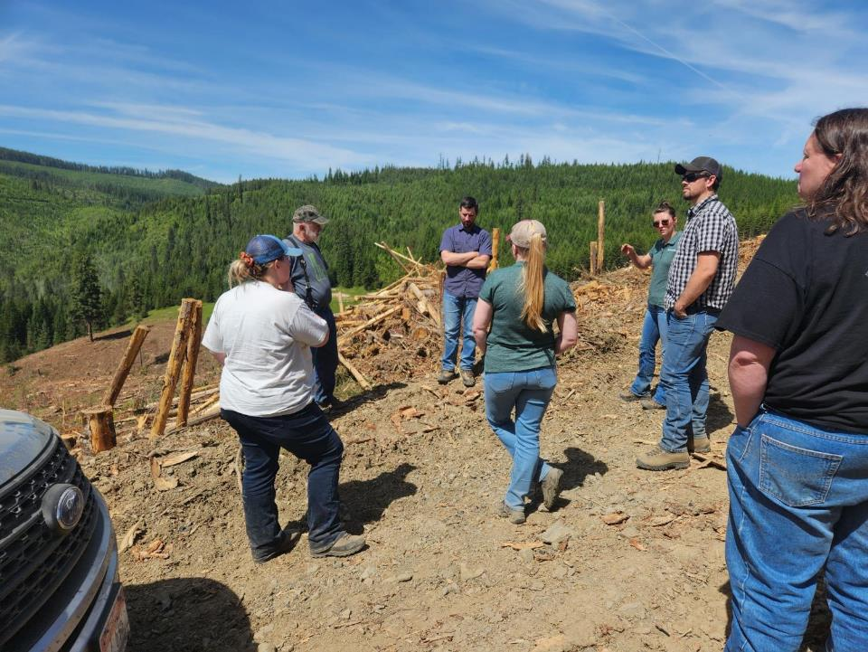
Audit Process
Notes:
Walk entire sale, especially stream crossings, drainage pipes and new roads.
Compare every situation to as many of the Rules as possible: 139 possible rules.
Total of Idaho Forest Practices Act rules: 2250 observations

Slide 7
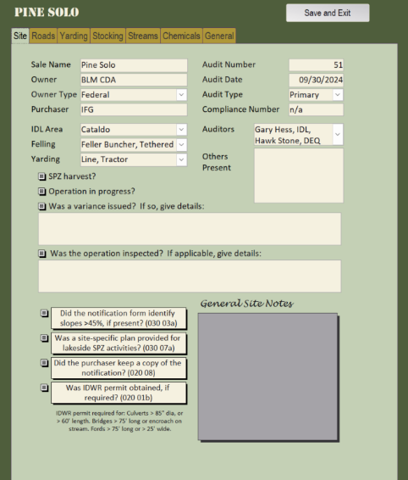
2024 Improvements
Further refined field forms
Incorporated new rules
Shade recovery study
More efficient

Slide 8
Overall Compliance
?
Out of 2,250 observations,
2,133 were in compliance
95%

Slide 9
Compliance – by Ownership
AVERAGE COMPLIANCE

Slide 10
Compliance Through the Years

Slide 11
Compliance Example

Slide 12
Number of Violations per Site

Slide 13
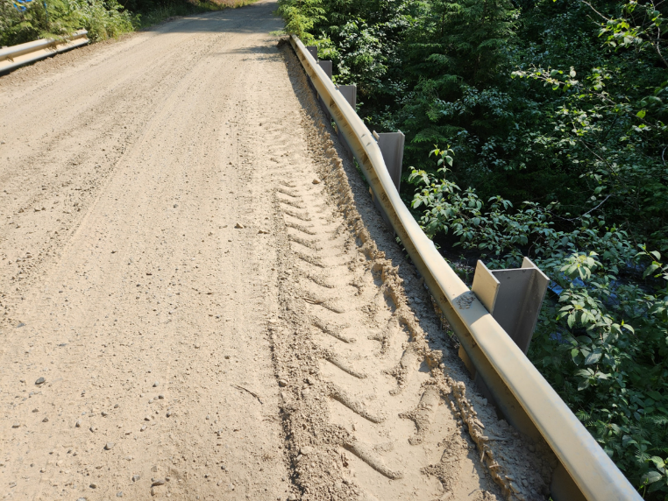
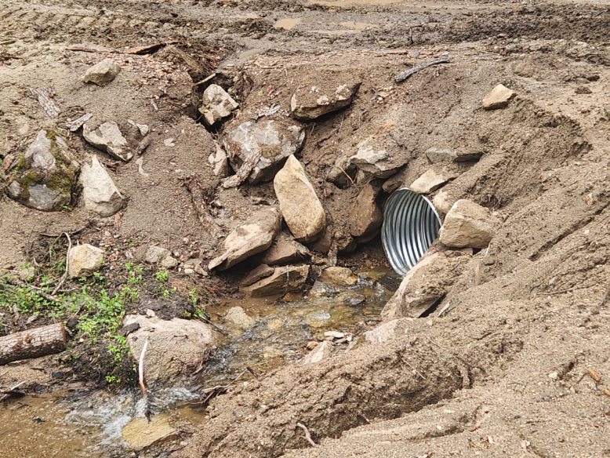
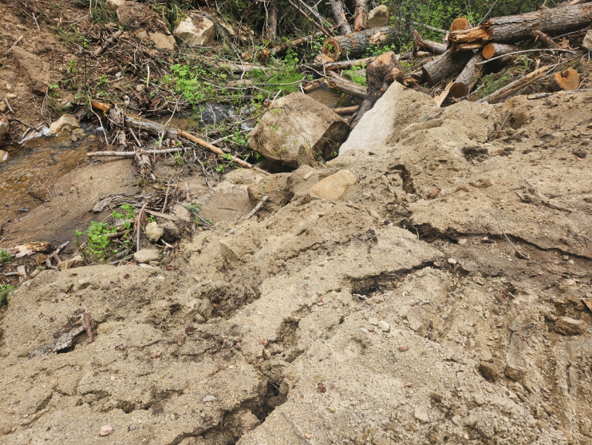
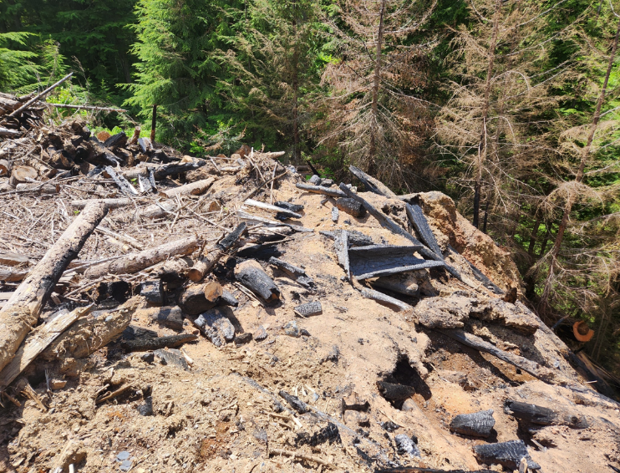
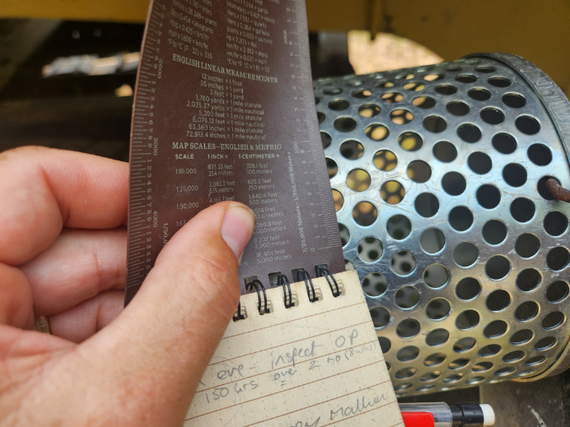
What were the Most Common/Serious Problems?
Bare dirt in the Stream Protection Zone from maintenance and construction (20% of violations)
Slash piles in the Stream Protection Zone
Culvert pipes too short and road fills unstable
Water-truck screens missing/too large
040.03(b): Clear all debris generated during construction… which potentially interferes with … water quality.
020.02(c)(iii): Water diversion intakes … must be screened with a maximum screen mesh size [of]… 3/32 inch [Class I streams]
040.04(a): Place all debris… associated with road maintenance in a manner to prevent [its] entry into streams.
030.07f(ii): No mechanical piling of slash… is allowed in an SPZ
Short culvert pipes & unstable fills

Slide 14
Comparison to 2020 Audit
We didn’t have to wear N-95 masks.
Grease tubes and oil buckets are still mostly being cleaned up (74% compliance in 2016, 95% in 2020, 88% this year).
More severe Stream Protection Zone violations –mostly from short culverts
Fish passage rules and shade rules much better this year.
Fewer ‘perfect’ sites

Slide 15
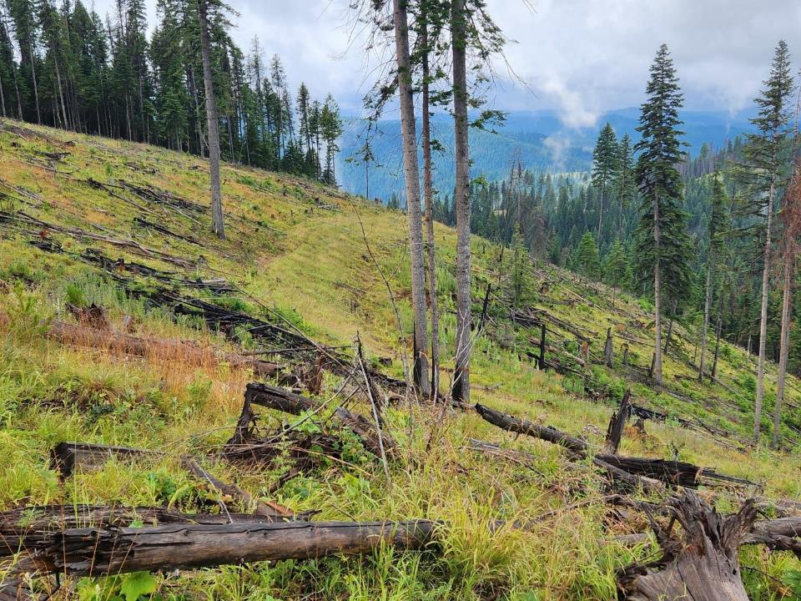
Perfectly decommissioned road

Slide 16
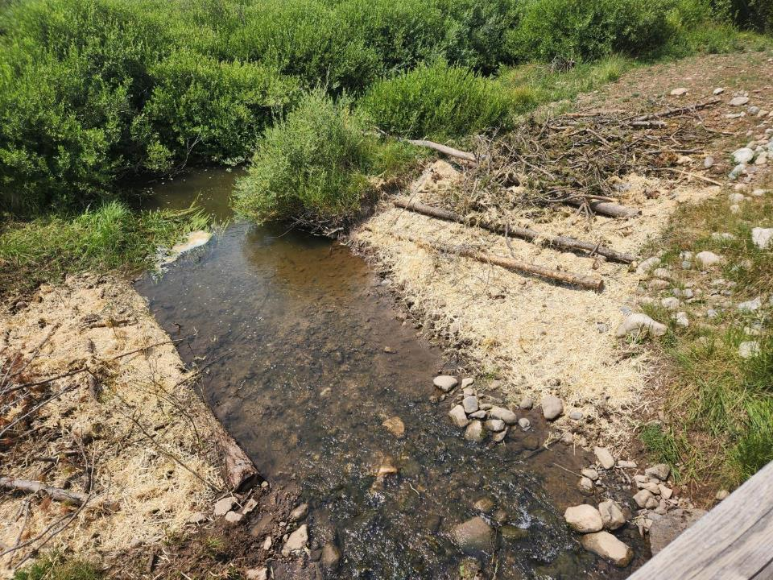
Nice temporary crossing

Slide 17
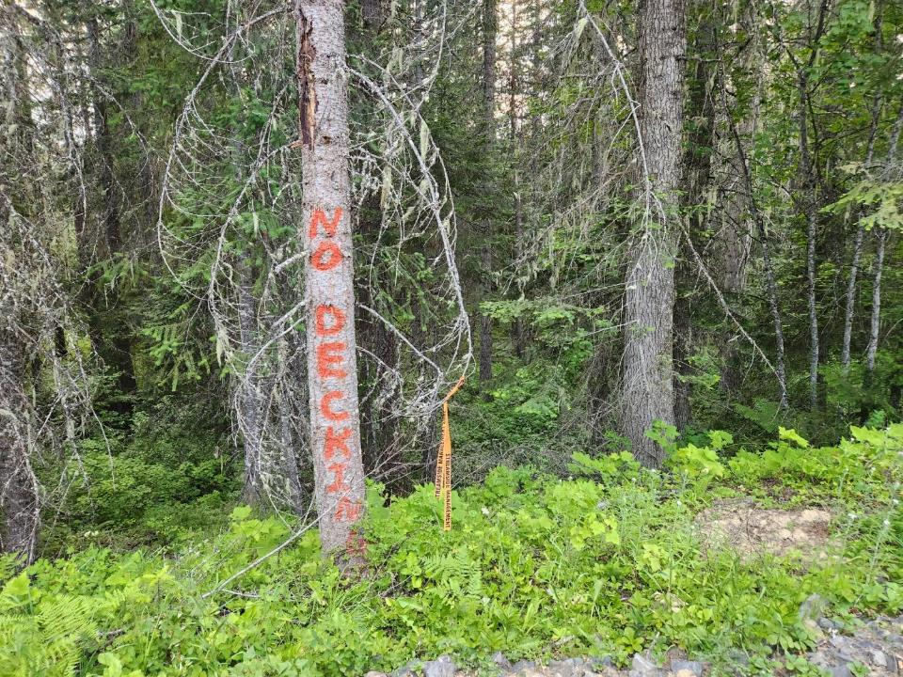
Clear instructions

Slide 18
Recommendations
IDL inspectors should pay extra attention to unstable bare dirt located near a stream.
Rule variances must be more carefully justified, and inspected. They should address temperature as well as sediment impacts.
Rule change: add requirement to stabilize erodible fills near the stream as soon as practical (instead of seasonally).
Rule change: require culvert pipes to be long enough to prevent erosion of the fill.
Rule change: explicitly prohibit large slash piles next to streams.

Slide 19
11 Weeks
27 Shade Sites
58 Audit Sites
119 Guests
2,250 Rules
20,000 Miles

Slide 20
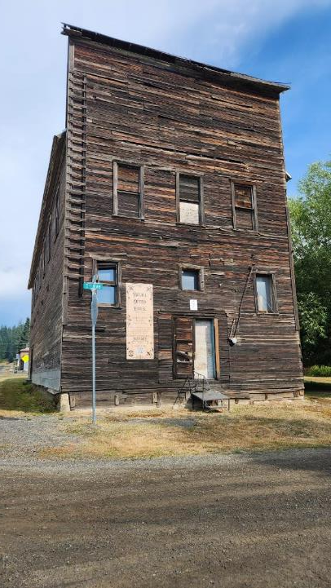

Slide 21
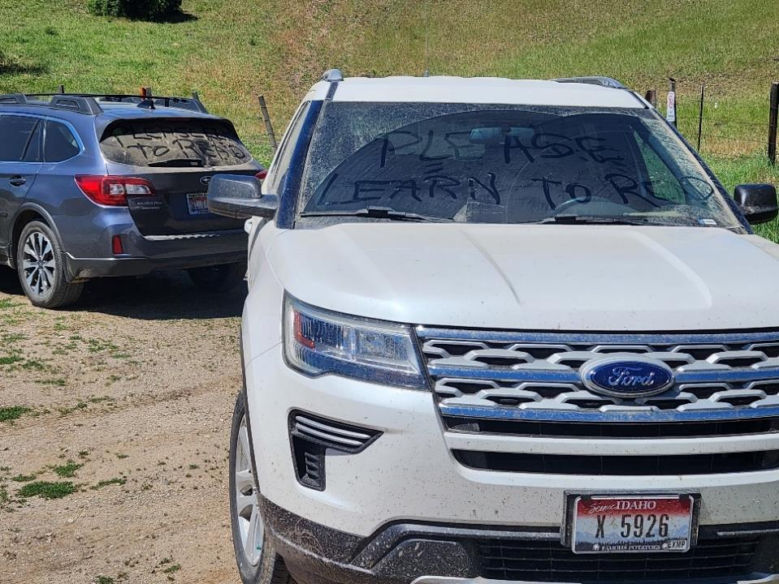
Questions?
www.deq.idaho.gov/forestry
www.idl.idaho.gov/forest-practices-act

