Slide 1
IDAHO FOREST PRACTICES
WHY WE HAVE IT
AND
HOW IT WORKS

Slide 2
IDAHO FPA SUMMARY
The Idaho Forest Practices Act promotes active forest management to ensure that the health of forest soil, water, vegetation, wildlife, and aquatic habitat is maintained and/or enhanced during the growing and harvesting of forest trees in Idaho.

Slide 3
FOREST PRACTICES IN IDAHO
TITLE 38
FORESTRY, FOREST PRODUCTS & STUMPAGE DISTRICTS
CHAPTER 13
FOREST PRACTICES ACT

Slide 4
FOREST PRACTICES IN IDAHO
POLICY OF THE STATE – PURPOSE OF THE ACT
(1) Recognizing that … forest lands make a vital contribution to Idaho by providing … social and economic benefits, by helping to maintain forest … resources, … it is the public policy of the state to encourage forest practices on these lands that maintain and enhance those benefits and resources for the people of the state of Idaho.

Slide 5
FOREST PRACTICES IN IDAHO
2) … it is the purpose of this chapter to vest in the board authority to adopt rules designed to assure the continuous growing and harvesting of forest tree species and to protect and maintain the forest soil, air, water resources, wildlife and aquatic habitat.

Slide 6
FOREST PRACTICES IN IDAHO
(3) No unit of local government shall enact any ordinance, rule or resolution which purports to regulate forest practices on the forest land in this state and which conflicts with any provision of this chapter.

Slide 7
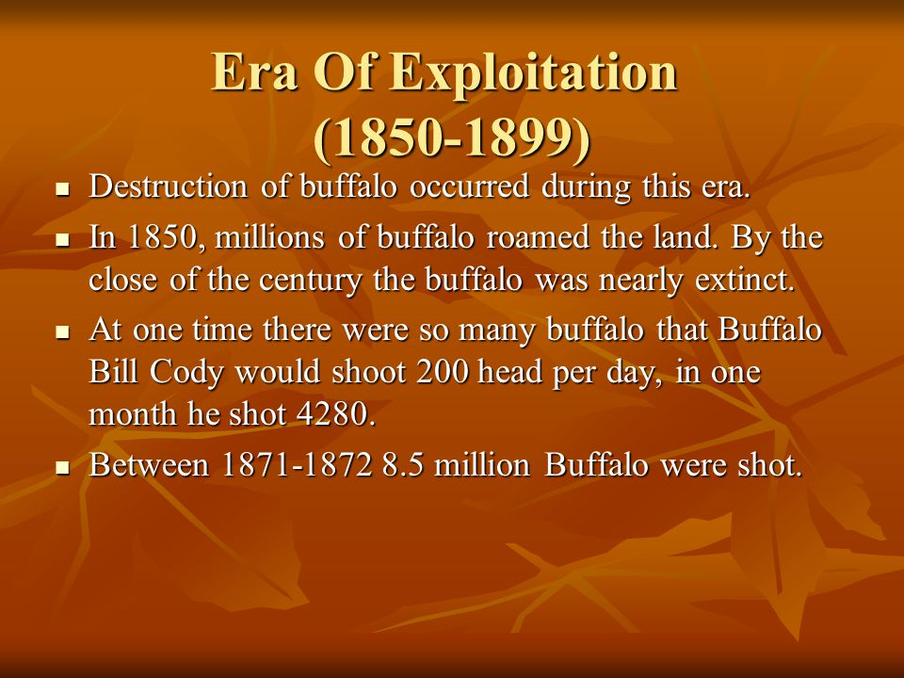
Exploitation was the Way

Slide 8
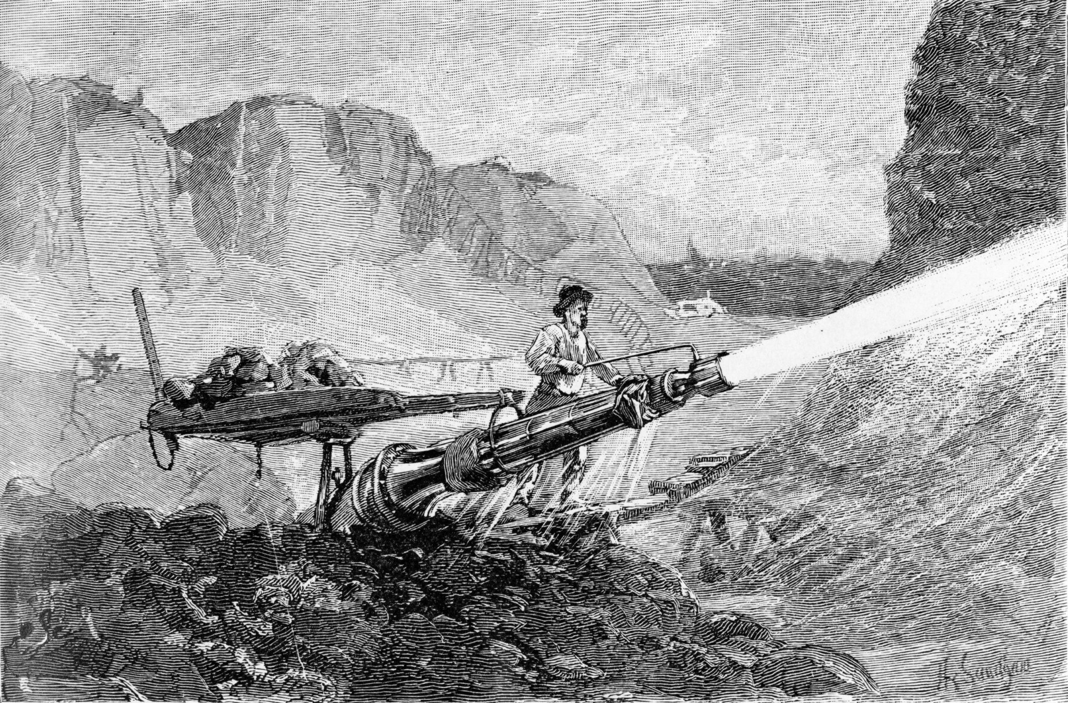
Exploitation was the Way

Slide 9
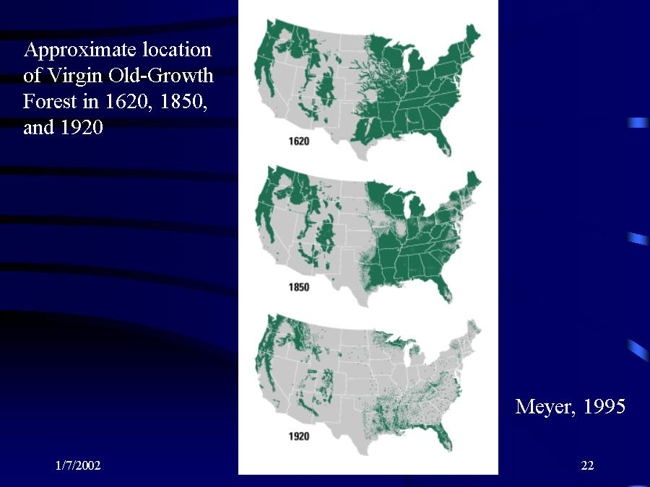
Exploitation was the Way

Slide 10
History of Forest Practices
The first Nat’l Park in 1872…Yellowstone
Federal Government started forestry management in 1876,
establishing a “Special Agent”
20 years of education and discussion ensued
1885: First state forestry boards established

Slide 11
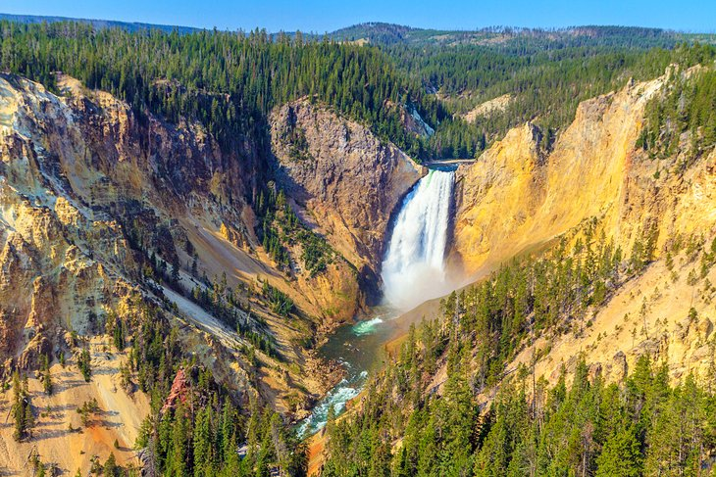
1st Nat’l Park - Yellowstone

Slide 12
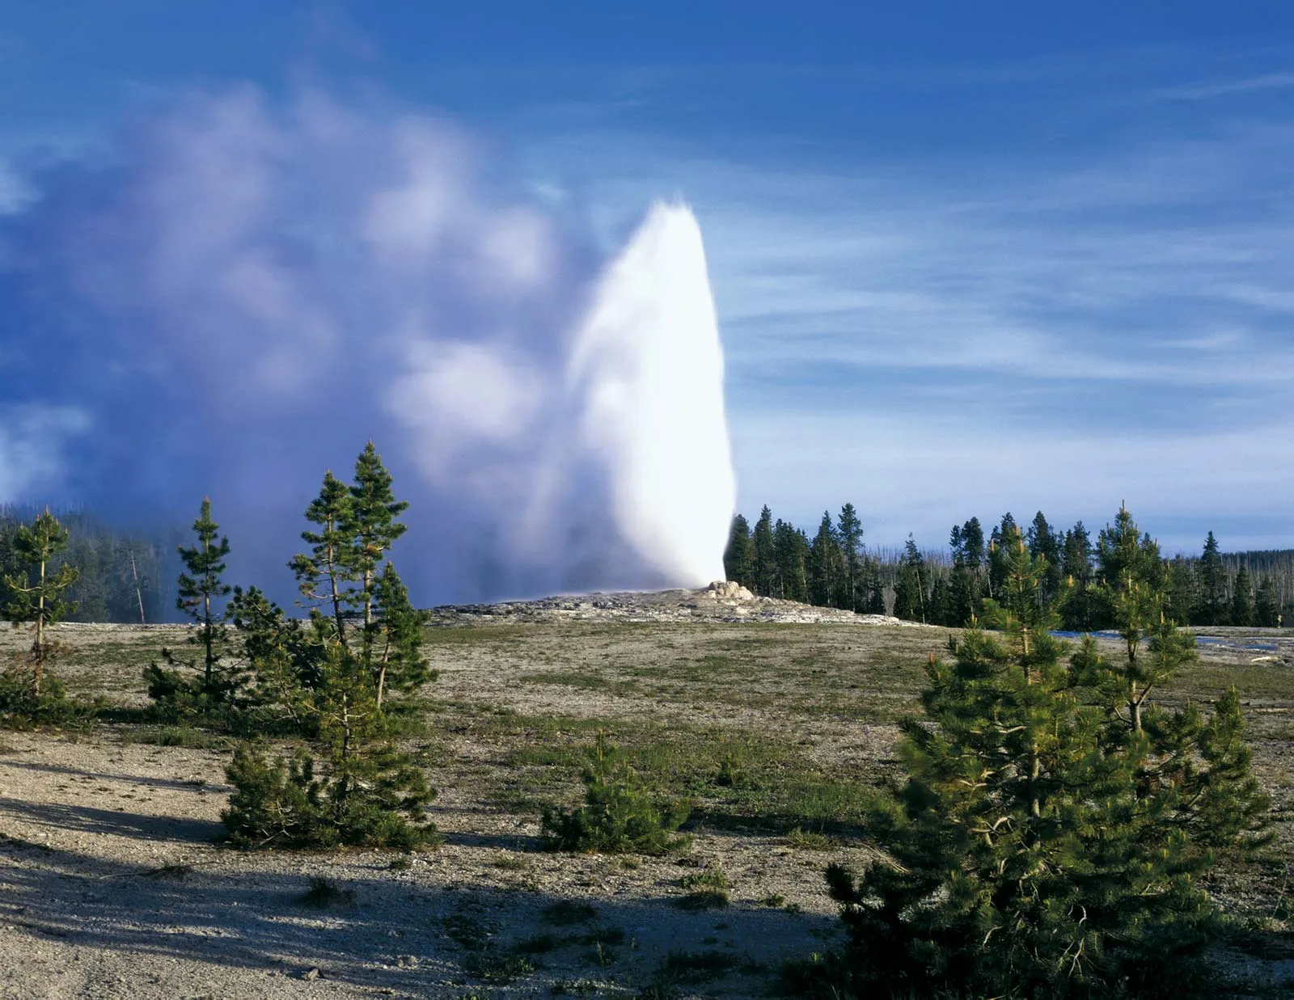
1st Nat’l Park - Yellowstone

Slide 13
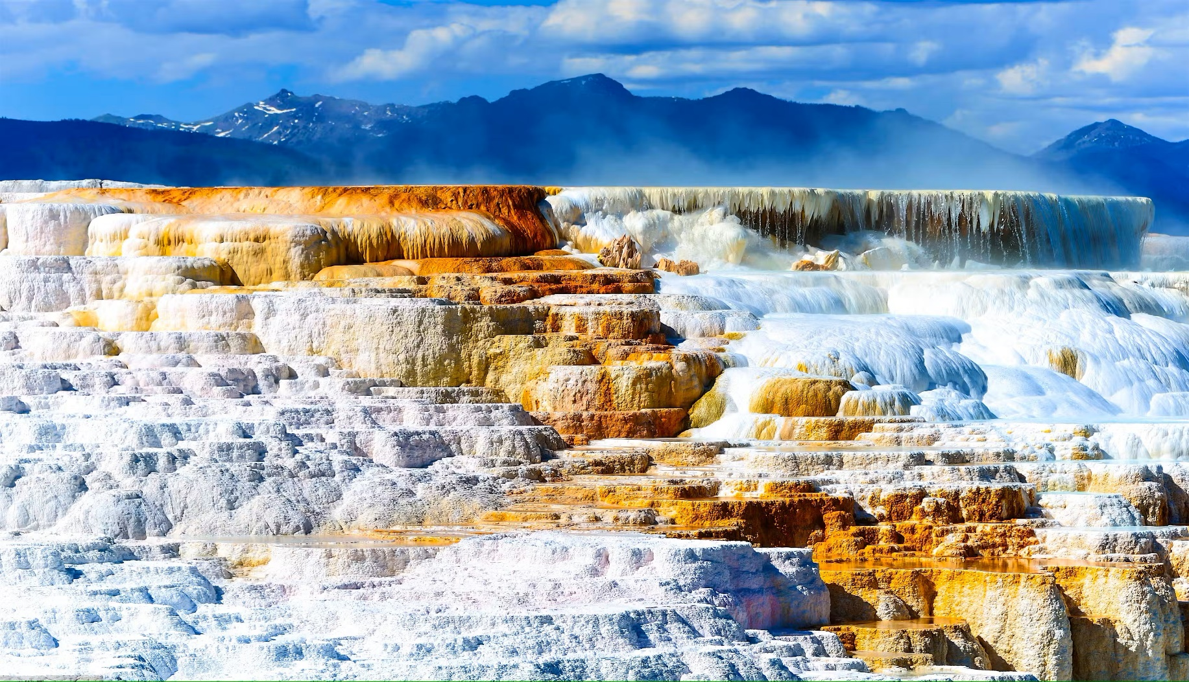
1st Nat’l Park - Yellowstone

Slide 14
History of Forest Practices
1890, Sequoia, Yosemite & Kings Canyon.
1898: Pinchot first Head of Forestry
1905: Roosevelt transferred forest reserves to
Dept of Ag, forming US Forest Service

Slide 15
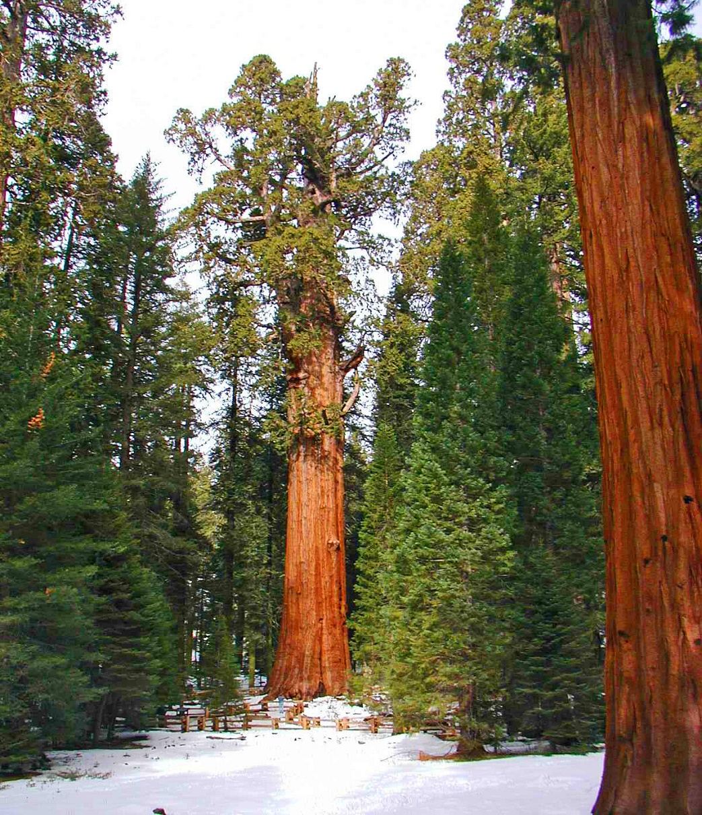
National Parks – 1870’s-90s

Slide 16
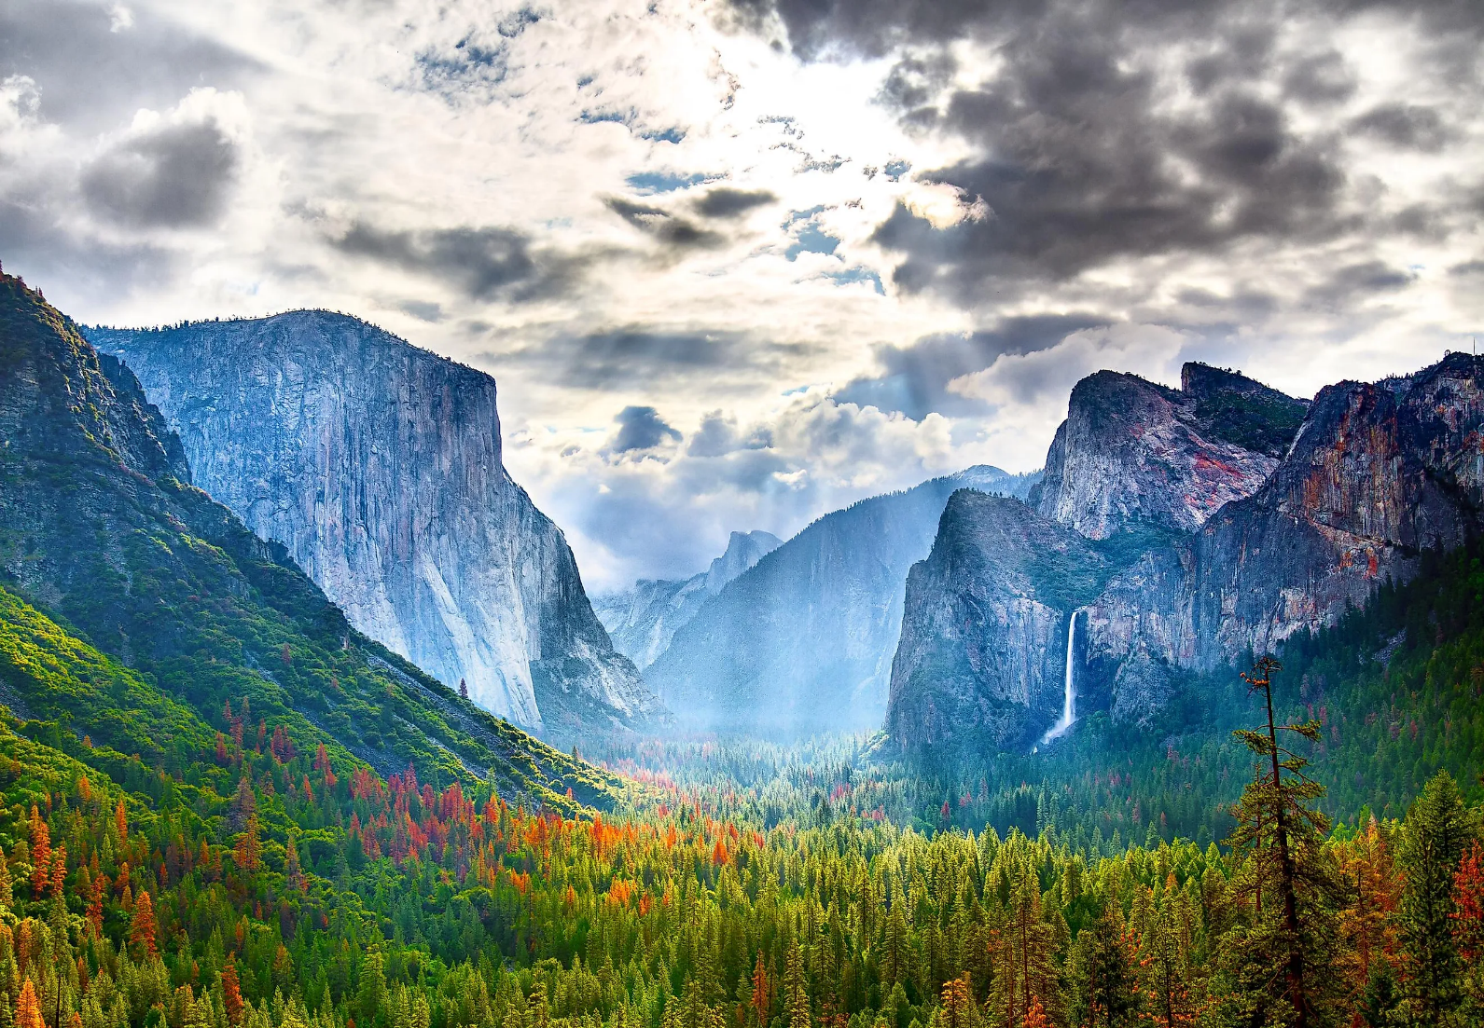
National Parks – 1870’s-90s

Slide 17
History of Forest Practices
Sequoia, Yosemite & Grant (later called Kings Canyon)…Grant & Sequoia later combined.
1885: California, Colorado, Ohio, set up boards of forestry…the start of state forestry.
1898, Pinchot head of Forestry Division
’05, 60 forest reserves (~56 million AC) become USFS, transferred from Dept of Interior to Ag.

Slide 18
History of Idaho Forest Practices
1904, First landowner fire control association
1925, Idaho Forestry Act…slash hazard reduction
1937, Idaho’s first Forest Practice Act, no provisions for soil or water protection
1972, federal Clean Water Act
1974, Idaho’s Forest Practice Act, ignored 1937 version…Repealed 1937 law in ‘87 at State Forester’s request
Nation’s first comprehensive Forest Practice Act, along with Nevada, California, Oregon, Washington.

Slide 19
RECENT CHANGES (2022)
In 2021 The Forest Practices Advisory Committee voted to recommend language to the State Board of Land Commissions which simplified the “Shade Rule” next to fish-bearing (Class I) streams and refine the definition of Class I streams to apply only to aquatic life beneficial use.

Slide 20
RECENT CHANGES (2022)

Slide 21
RECENT CHANGES (2022)

Slide 22
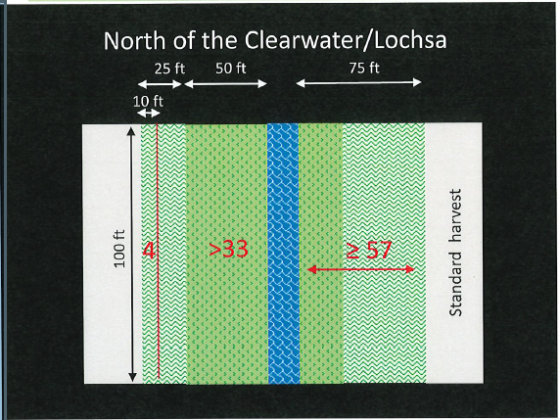
RECENT CHANGES (2022)

Slide 23
RECENT CHANGES (2022)
Rules specific to the use of ground-based equipment on steep slopes have also been updated due to technological changes in the industry which allows machinery to operate safely on steep slopes while minimizing soil disturbance.

Slide 24
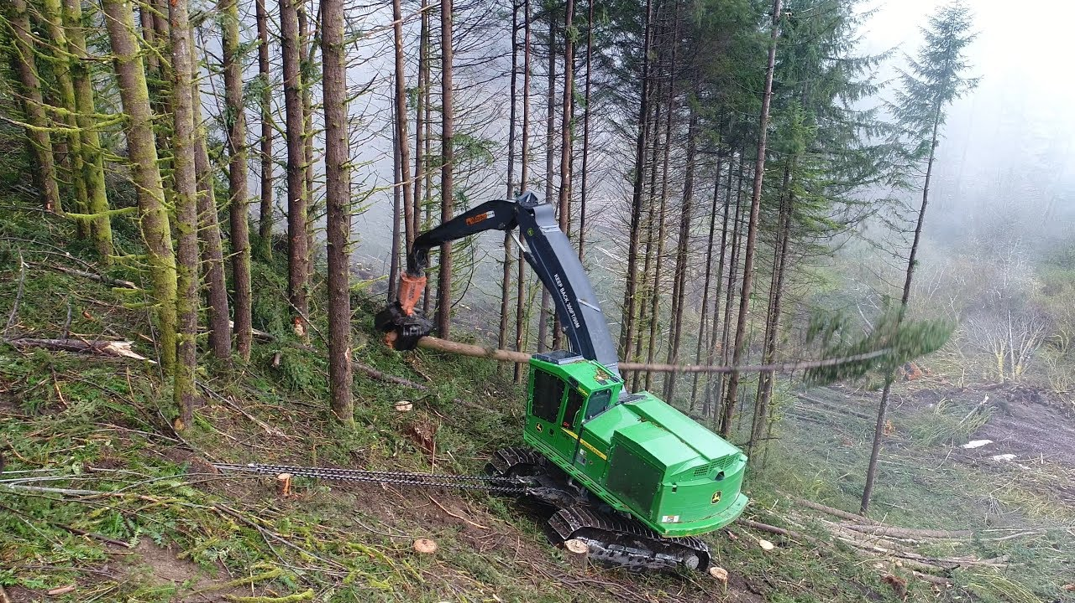
TETHERED (2022)

Slide 25
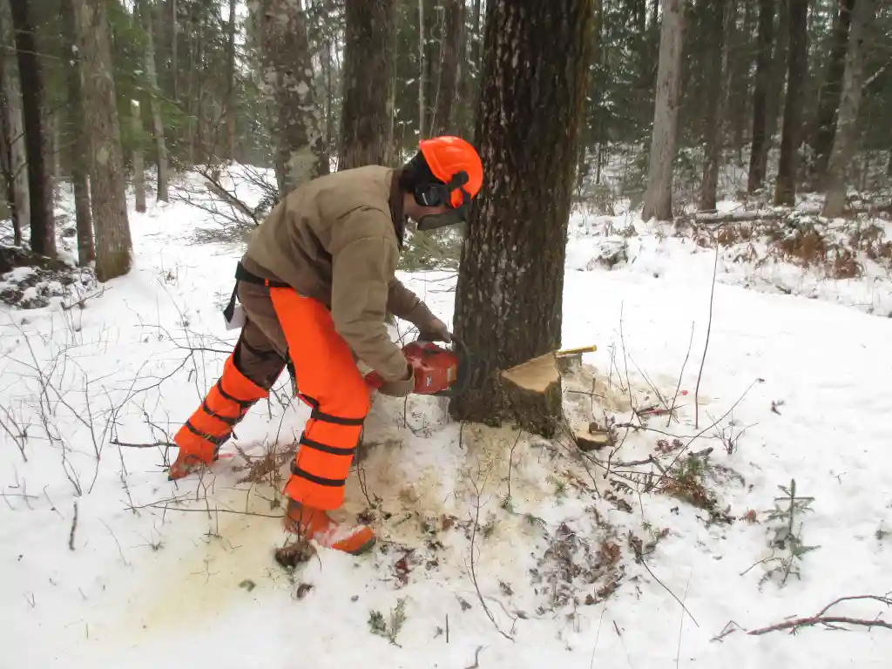
Hand Falling

Slide 26
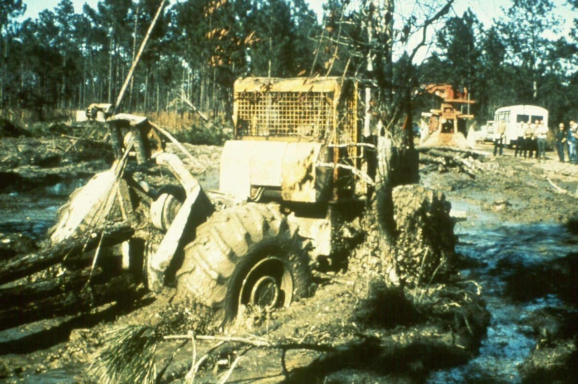
HMMM…

Slide 27
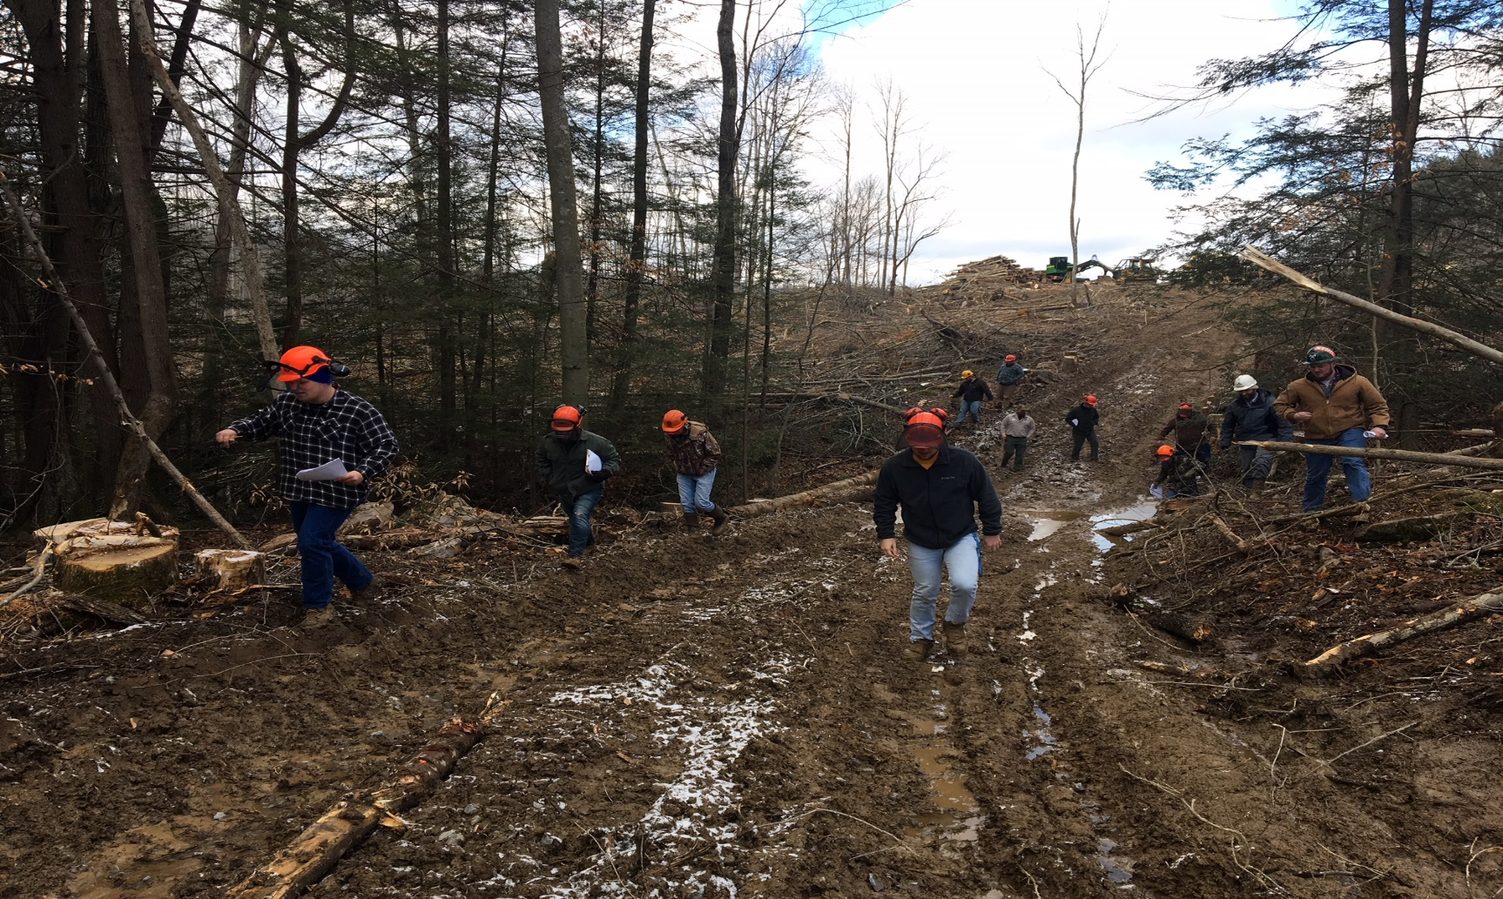
Maybe too wet? Where’s the water?

Slide 28
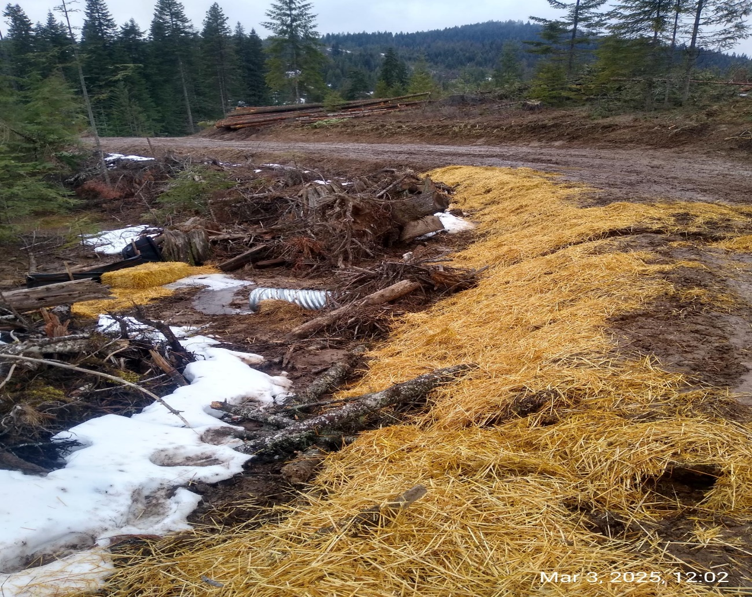
Mitigate erosion

Slide 29
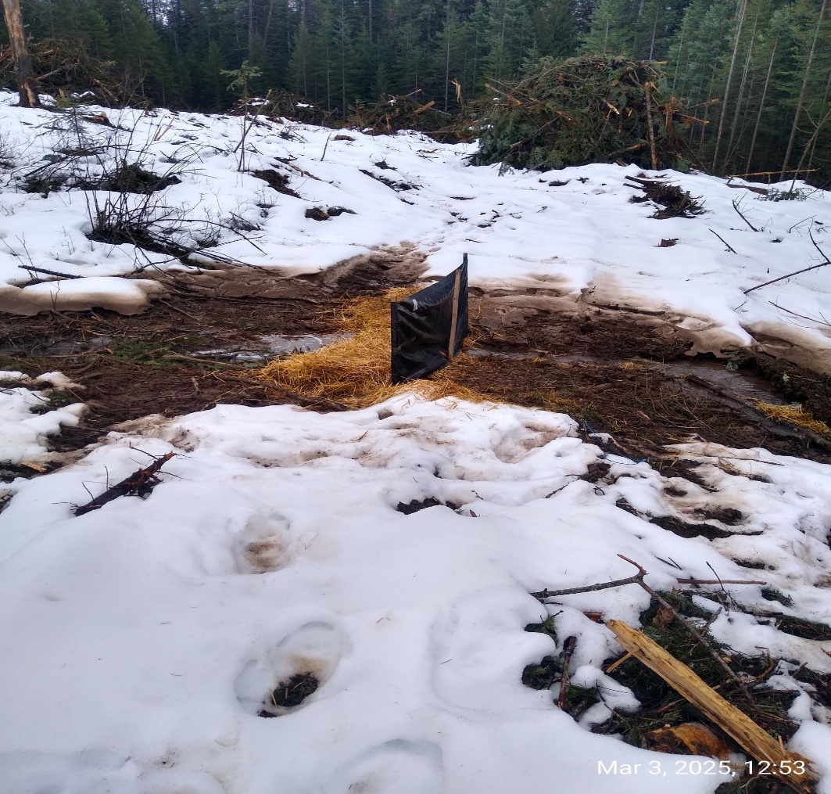
Silt fence/straw bales

Slide 30
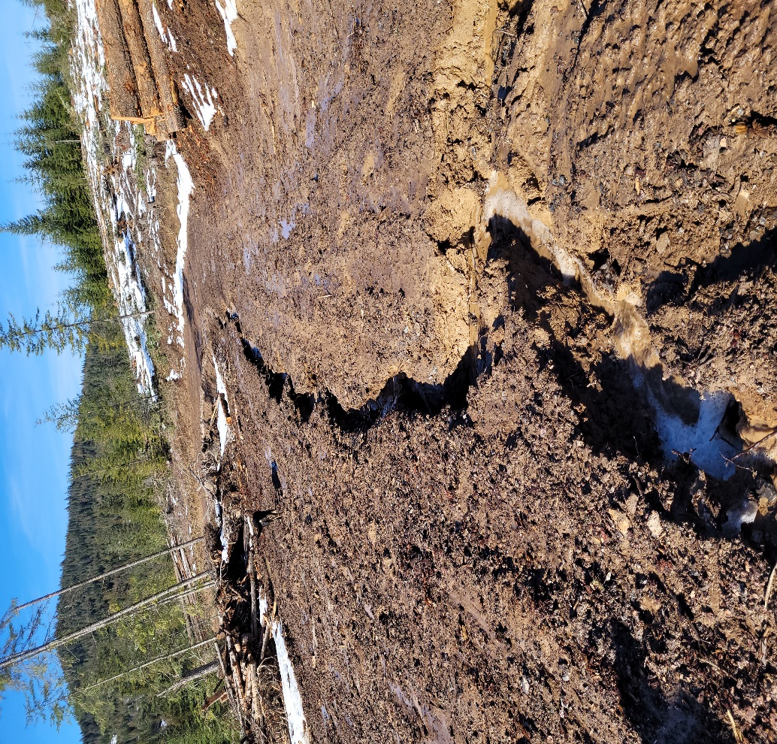
Eroding trails /roads make…

Slide 31
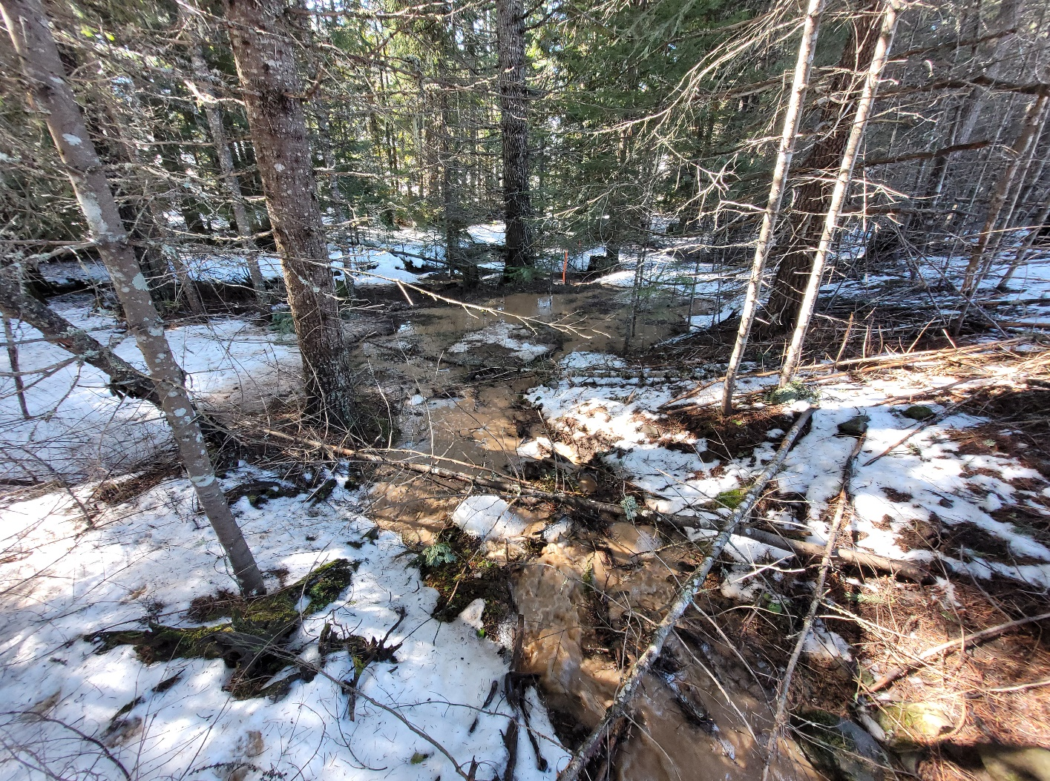
Muddy creeks!

Slide 32
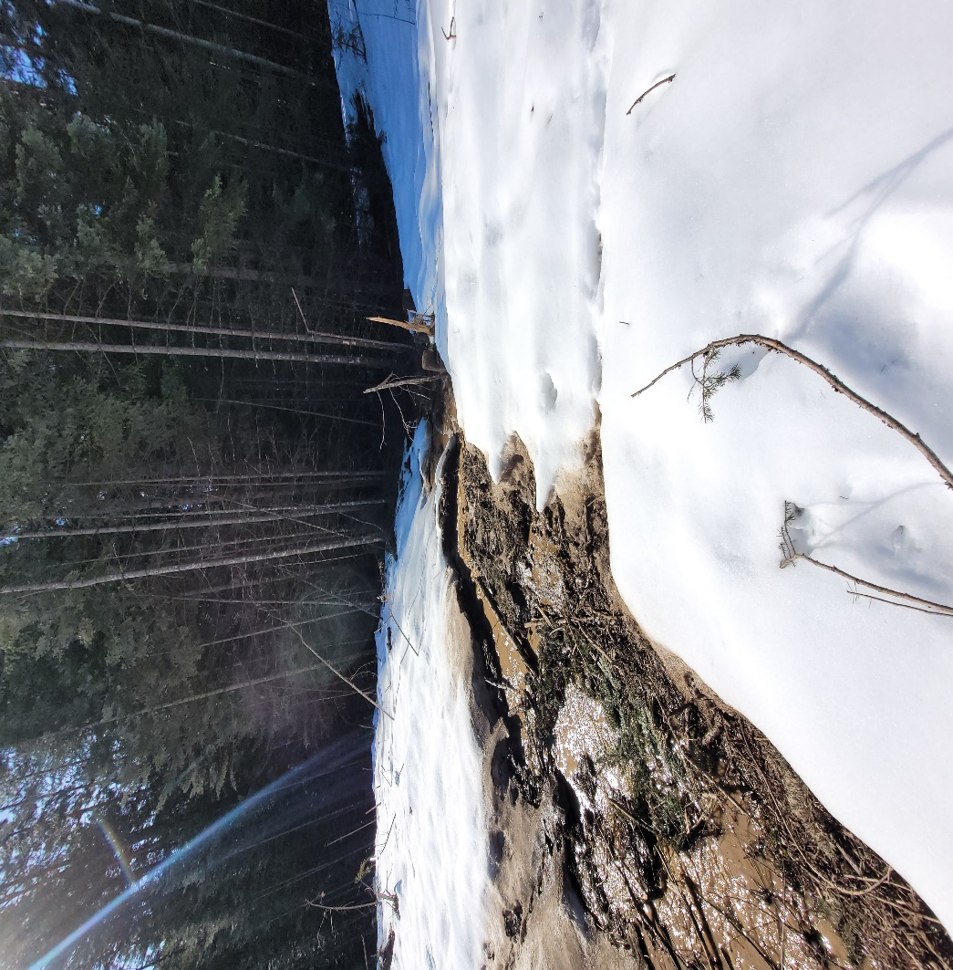
Rain on snow, active logging

Slide 33
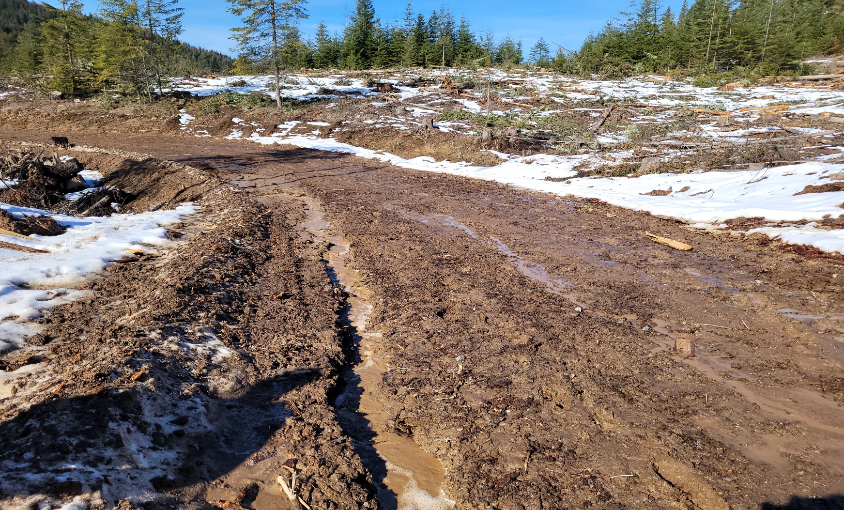
Native surface, recent logging

Slide 34
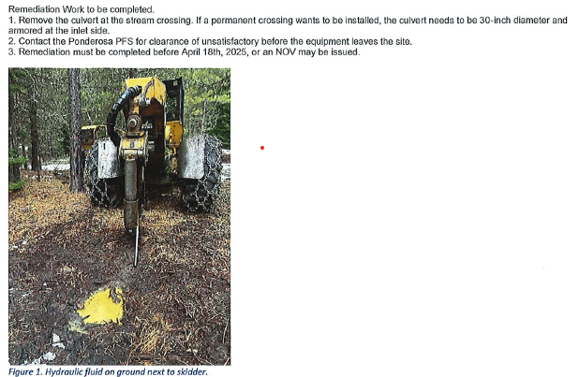
Protect water from hydraulic fluid

Slide 35
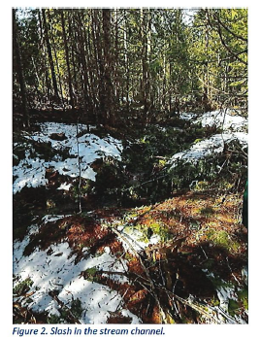
Slash in stream channel

Slide 36
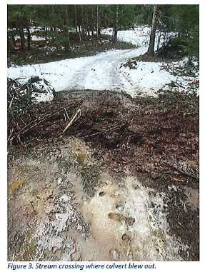
Blown culvert

Slide 37
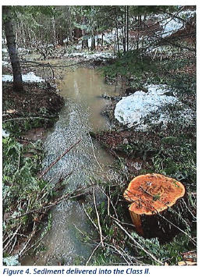
= Sediment delivery

Slide 38
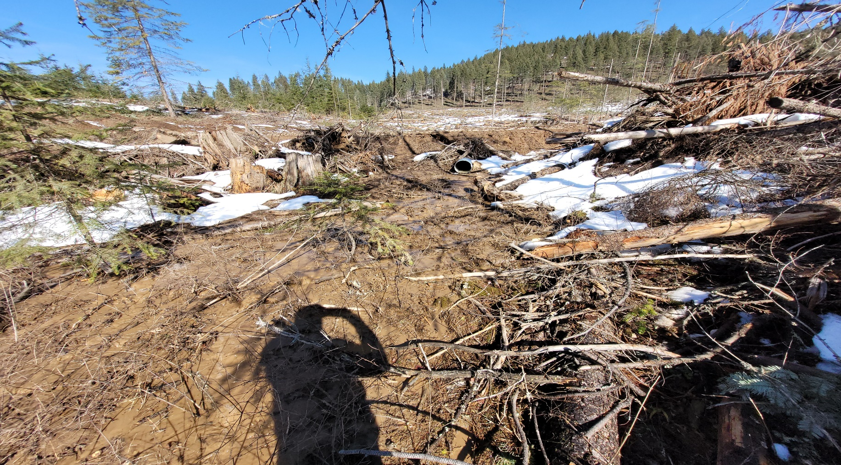
Disturbed soil, possible delivery

Slide 39
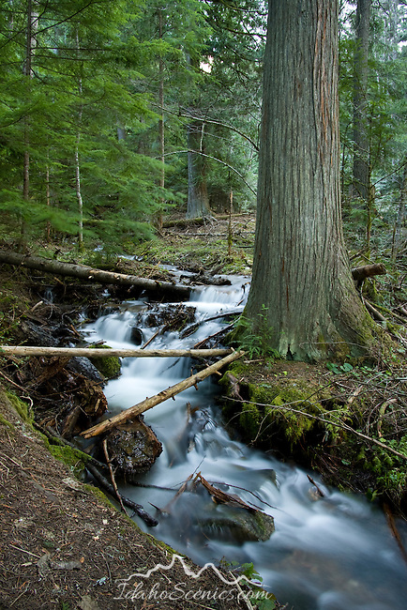
Leave trees near stream, soil stability

Slide 40
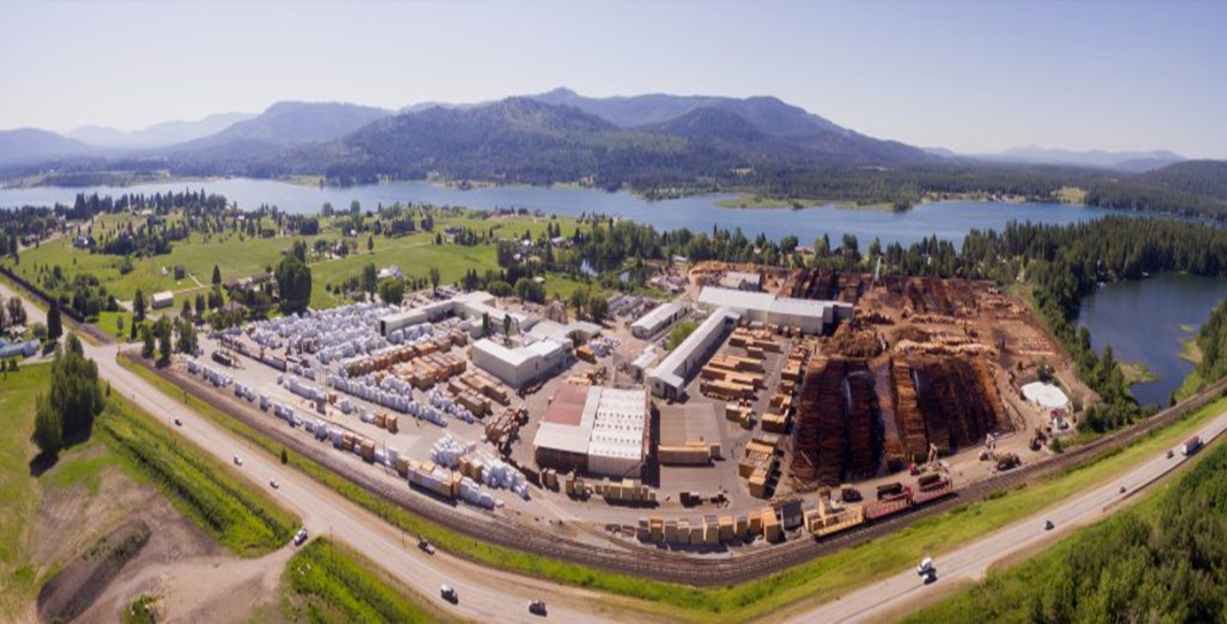
FPA / Social License

Slide 41
FPA / Social License
Certification: Submitting to external
audits to assure customers
that forests are sustainably
managed and all applicable
rules & regulations are faithfully
followed

Slide 42
FPA / Social License
NIPF (Non-Industrial Private Forest) owners
are NOT required to have 3rd party
forest certification.
Mills being certified only requires a certain
percentage of their logs (woody materials) to
come from certified lands

Slide 43
FPA / Social License
Pulp mills have ~97% certified fiber
Plywood, OSB & panel products have
~88% certified fiber
Lumber mills have ~55% certified logs

