Slide 1
The top 5 ways Forest Landowners save Taxes
Andrew Bosserman, CPA
2025 Idaho Family Forest Landowners & Managers Conference

Slide 2
Andrew Bosserman, CPA
About Me
Born and raised in Toledo, OH
Graduated from Miami University (OH) with degrees in Accounting and Finance
Certified Public Accountant
Former IRS agent in Cincinnati, OH
Owned and operated Miami Valley Tree Farm in Cedarville, OH from 2015 - 2018
Graduated from Wake Forest School of Law and practices tax law in Charlotte, NC
Author of tax articles in Woodland Magazine, Journal of Taxation, and Great Lakes Christmas Tree Journal
Provides tax, accounting, and consulting services to forest landowners and Christmas tree growers at AndrewBosserman.com

Slide 3
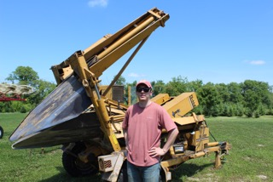
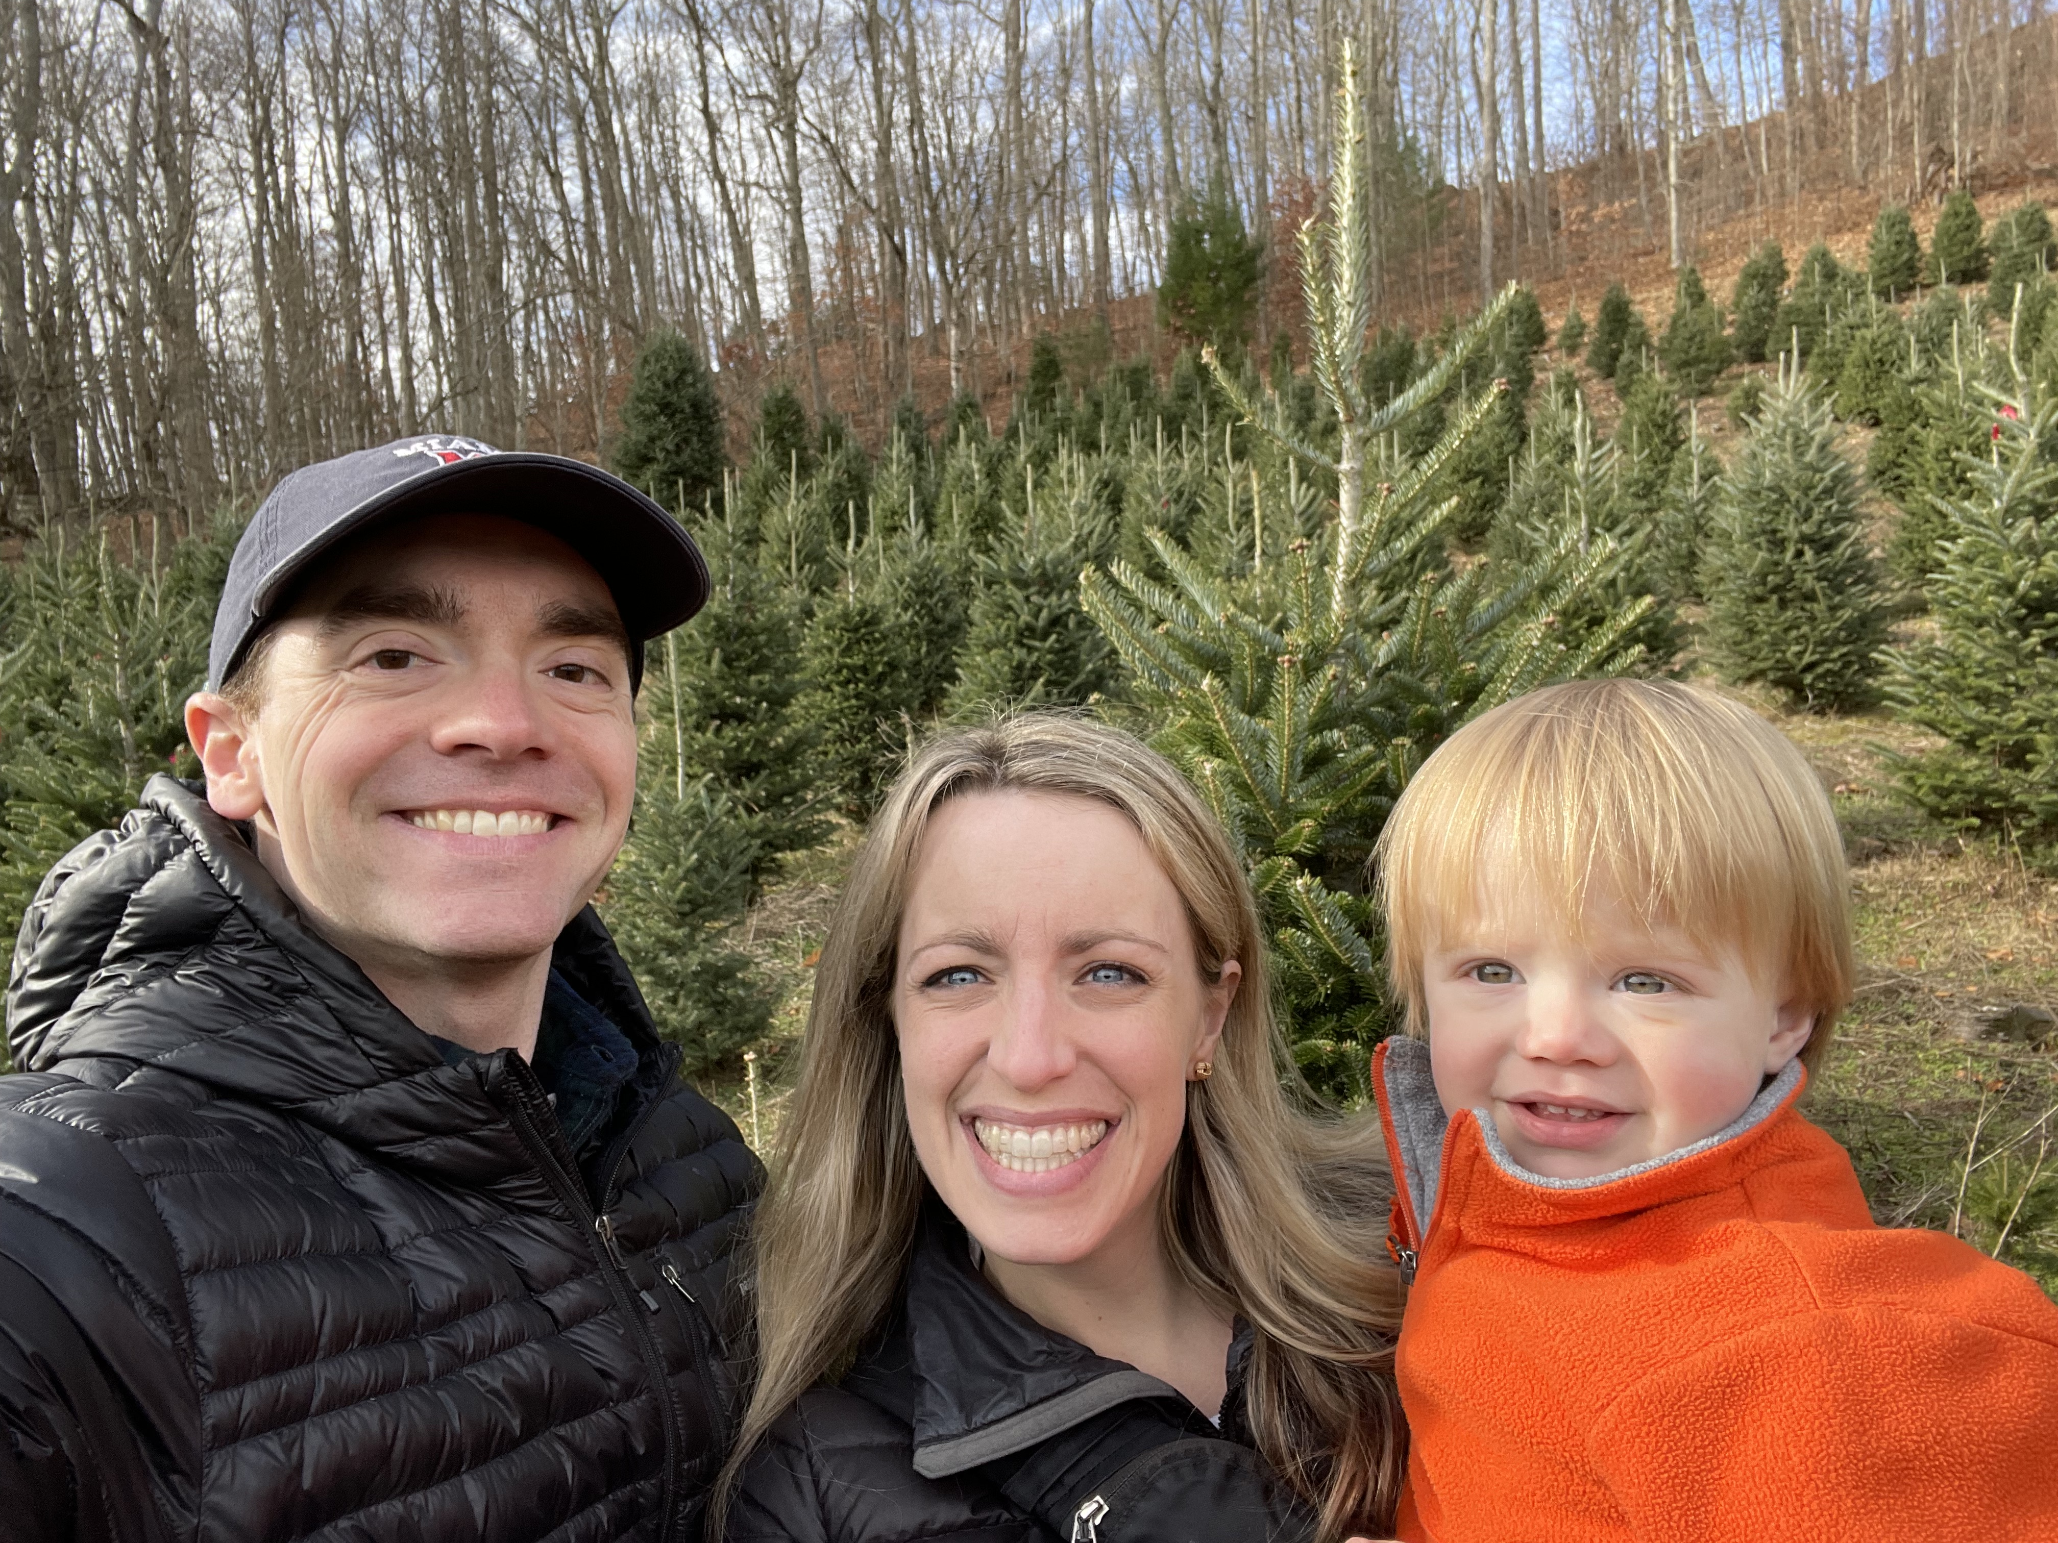
With Blue Spruce seedlings - 2018
With tree spade - 2018
Choosing our Christmas Tree! - 2023
Family of Four! – Dec. 2024

Slide 4
Disclaimer
The information presented is for informational purposes only and is not intended to provide specific tax or legal advice. Each individual situation is different and consultation with your own personal tax professional is strongly recommended before acting on any of the information contained in this presentation.

Slide 5
“The Hardest Thing to Understand in the world is the Income tax.”
Albert Einstein

Slide 6
Summary
Top 5 Ways Forest Landowners Save Taxes
Operate Forest Land as a Business vs an Investment
Elect Capital Gain Treatment on Timber Sales
Maximize Timber Cost Basis
Deduct Qualified Reforestation Expenditures
Choose the Best Business Entity

Slide 7
Operate Forest land as a business rather than an investment
1

Slide 8
Activity Tax Classification
Three Options
Business
Investment
Personal
1
2
3

Slide 9
How to Classify
Business
Investment
Two Requirements:
Entered into primarily for profit
Owner’s motive for growing timber
Is forestland run like a business?
Ex: business plan, organized books/records, attempting to earn a profit
Regularly and continuously carried on
How much time does the owner spend managing the forestland?
No or minimal profit motivation
Own property primarily for hobby, recreation, or personal residence
Does not meet the two Business Requirements
Still motivated by profit vs personal or hobby reasons
Personal
Note: Classification is highly fact-specific

Slide 10
Why is proper classification important?
Business Classification Generally Results in a Lower Tax Liability
Business
Investment
Personal
Any loss is often fully deductible against other income
All ordinary and necessary expenses are deductible
All income is taxable
Very few (if any) expenses are deductible
All income is taxable
No expenses are deductible (except possibly some personal itemized deductions)
Loss is not deductible

Slide 11
Elect Capital Gain Treatment on Timber Sales
2

Slide 12
Ordinary Income vs Capital Gain Income
Ordinary Income | Capital Gain Income
Most often wages, interest income, and self-employment/business income | Profit from the sale of an investment held more than one year
All income other than capital gain income | Most often from the sales of stocks, bonds, or real estate
Taxed at ordinary income rates (highest rates) | Taxed at preferential rates
May be subject to employment taxes | Not subject to employment taxes
 | Sales of timber can qualify

Slide 13
Why a Capital Gain Election Is powerful
Tax Rate Comparison & Avoiding Self-Employment Tax
Note: Self-Employment Tax
An additional 15.3% on top of the above rates
Social Security & Medicare tax
Only assessed on ordinary, earned income (not capital gain income)

Slide 14
IRC § 631 to the rescue!
Receive capital gain treatment even in a business activity
IRC § 631(a)
IRC § 631(b)
Covers timber the owner cuts himself or pays someone else to cut
Requirements
Owned the trees or had the right to cut them for more than one year
Owner must cut the timber himself or pay someone else to cut it for him
Must split sales proceeds into two amounts:
Gain from holding standing timber until cutting; and
Added value from converting the standing timber into logs or wood products
Elect 631(a) treatment on Form T
Covers standing timber sold outright or with a retained economic interest (pay-as-cut)
Requirements
Owned the trees or had the right to cut them for more than one year
Trees sold as standing timber
No splitting of sale proceeds or election on Form T necessary like 631(a)
However, will likely have to file Form T anyways with tax return
Report capital gain (or loss) correctly on tax return

Slide 15
maximize Timber Cost Basis
3

Slide 16
Why Does cost basis matter?
Three Main Reasons
Depletion Deduction
Casualty Deduction
Basis of Future Owner
1
2
3

Slide 17
Remember this fundamental principle
Cost Basis ≠ Market Value*
*Unless you inherit property that receives a stepped-up basis

Slide 18
How to Allocate Basis
Example
Paul Bunyan purchased 50 acres of forestland in 2025 for $100,000.
The Fair Market Value (FMV) of the land was $50,000, the FMV of the existing timber was $40,000, and the FMV of existing logging roads were $30,000 (FMV Total = $120,000).
How should Paul allocate the $100,000 cost between the purchased assets?
Land cost basis = ($50,000 / $120,000) * $100,000 = $41,667
Timber cost basis = ($40,000 / $120,000) * $100,000 = $33,333
Land Improvements (logging roads) cost basis = ($30,000 / $120,000) * $100,000 = $25,000
Appraisal of timber at time of acquisition is extremely important!

Slide 19
Inside Basis vs outside basis
Applies to Most Entities
Inside Basis
Entity’s basis in the assets
Ex: cost basis of timber
Outside Basis
Owner's basis in the ownership interest
Ex: cost basis of LLC interest
Generally receives a stepped-up basis when inherited
Generally does not receive a stepped-up basis unless a 754 election is made (for a partnership)

Slide 20
Deduct Qualified Reforestation Expenditures
4

Slide 21
Qualified Reforestation Expenditures
Direct expenses incurred in establishing a stand of timber
Ex: cost of seeds/seedlings, land preparation/clearing, etc.
Does not include:
Timber stand improvement practices
Establishment of a Christmas tree plantation
Planting windbreaks or other trees not intended to be harvested for timber

Slide 22
Two ways to Accelerate Tax Deductions
Combine both ways to maximize deductions!
General Rule
Reforestation costs must be capitalized and deducted when the timber is sold or harvested
Exception A – IRC § 194(b)
Qualified reforestation expenditures may be immediately expensed up to a maximum of $10,000 per tax year per Qualifying Timber Property
Exception B – IRC § 194(a)
Can amortize qualified reforestation costs over 84 months (8 years)
All eligible costs may be amortized, not just up to $10,000

Slide 23
Choose the best Business Entity
5

Slide 24
Two Main Types of Entities
Taxable | Non-Taxable
Entity itself pays tax | Entity does not pay tax; profit and loss “passes through” to owners
Subject to double-taxation | No double-taxation
C-corporations, some trusts | S-corporations, partnerships, many LLCs, some trusts
Result in lower taxes if owners can defer taking money out of the corporation | Result in lower taxes in many situations

Slide 25
Considerations when choosing an entity
How many owners will there be?
Who are the owners going to be?
Do the owners need to take money out of the company regularly?
What are the owners’ future plans?
Plan to sell forestland or leave to heirs?
How business-savvy are the owners?
Will the business be electing capital gain treatment under IRC § 631?

Slide 26
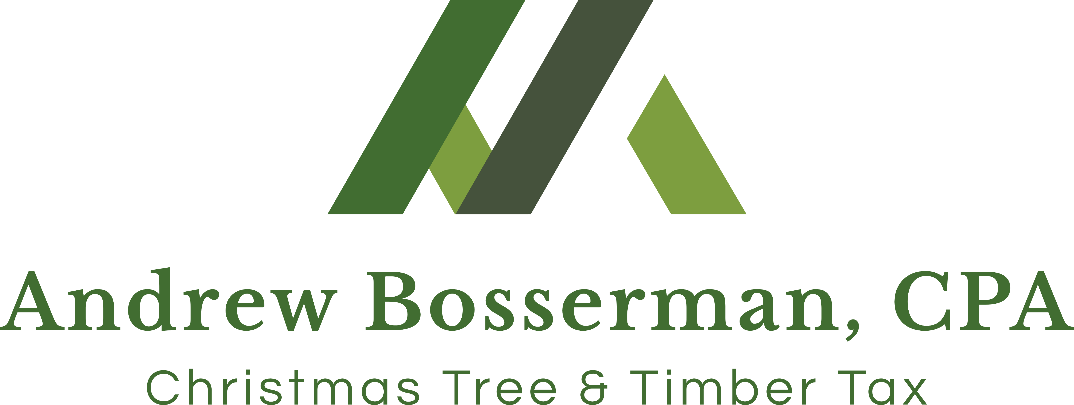
Questions?
andrew@andrewbosserman.com
www.christmastreetax.com

