Slide 1
Forestry Equipmenet for the sMall landowner: A Waterfowl Farm Case Study

Slide 2
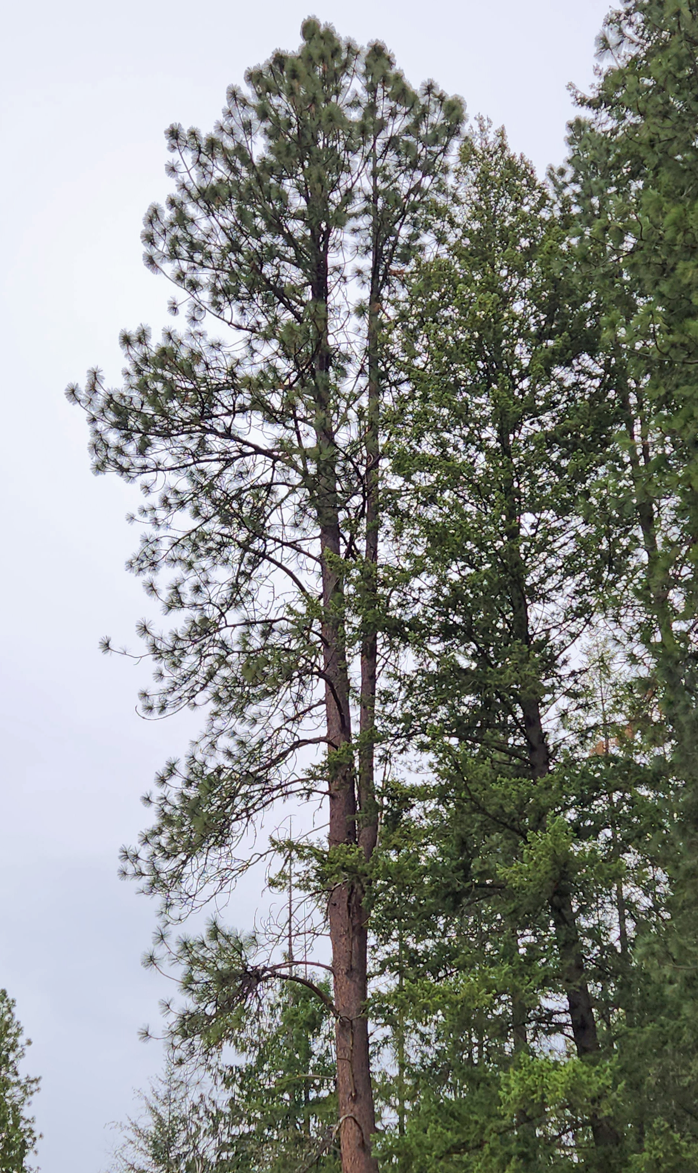
Waterfowl Farm
80-acre operation in southern Bonner County.
70-acre mixed conifer forest (Red Cedar, Western Hemlock, Douglas Fir, Grand Fir, Western Larch, and Ponderosa Pine)
Four commercial harvests over the past 35 years.
Forest is managed for:
Forest health
Timber production
Firewood
Lumber/beams for farm projects
Guiding principle: As far as possible, forest management pays for itself.

Slide 3
Hands to the Plow
70-year-old owner
40-year-old son-in-law
35-year-old daughter
5-year-old grandson
Consulting forester
Professional logging crews

Slide 4
Challenges
Processing firewood for three homes each year,
Keeping skid trails, logging roads, and fences clear of blow downs,
Harvesting trees for farm projects, and
None of us are getting any younger.

Slide 5
solutions
Rely on my consulting forester and a qualified logging company for the big jobs.
Recognize that we must invest in good equipment to work safely and efficiently in the woods.
Thank God for the internal combustion engine and the power of hydraulics!
Recognize that not all of my logs have to go to the mill. Some can stay on the farm to reduce the cost of farm and home projects.

Slide 6
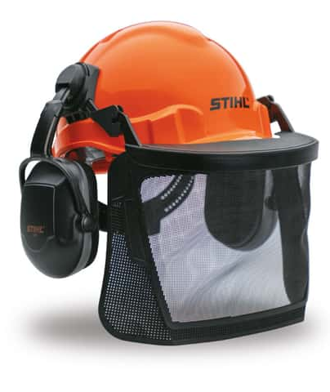
Safety equipment
Helmet with face shield or safety glasses
Ear protection
Leather gloves
Kevlar chaps
Steel-toed boots

Slide 7
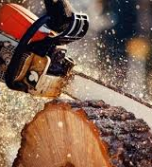
Chainsaw
Needed to fell trees on a limited basis and/or to cut up blow downs for firewood or lumber use.
Gas operated w/ at least a 22” bar for big jobs.
Battery operated for removing branches from downed trees and for thinning/pruning.

Slide 8
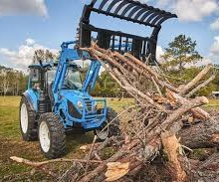
tractor
Critical to handling small to medium forest management jobs.
Minimum hp is 30; 50 hp is better.
PTO/hydraulic capability is a must!
Recommended attachments: grapple and forks.

Slide 9
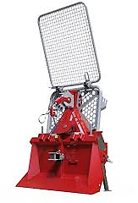
winch
Makes logging jobs safer and more doable.
Can be used to direct the fall of a tree as well as drag logs out of the woods.
Tajfun Logging Winch ($4000-$22,000 depending on size/features)
Wallenstein Skidding Winch ($4400-$9500 depending on size/features)

Slide 10
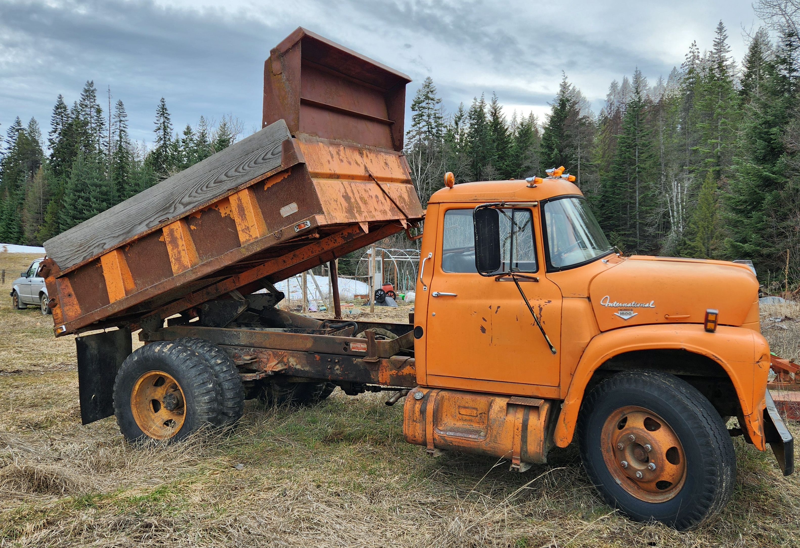
Trailer
Dump trailer or track sized to haul logs and/or firewood.
International Harvester 1600 Loadstar

Slide 11
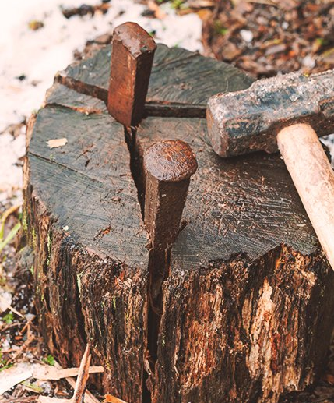
Firewood
Most labor-intensive job on the farm.
Must be done each year to supply three households with the wood needed for winter heat.
Total of 12 cords needed each year.
Firewood processor pays for itself in reduced chiropractic fees and aspirin.

Slide 12
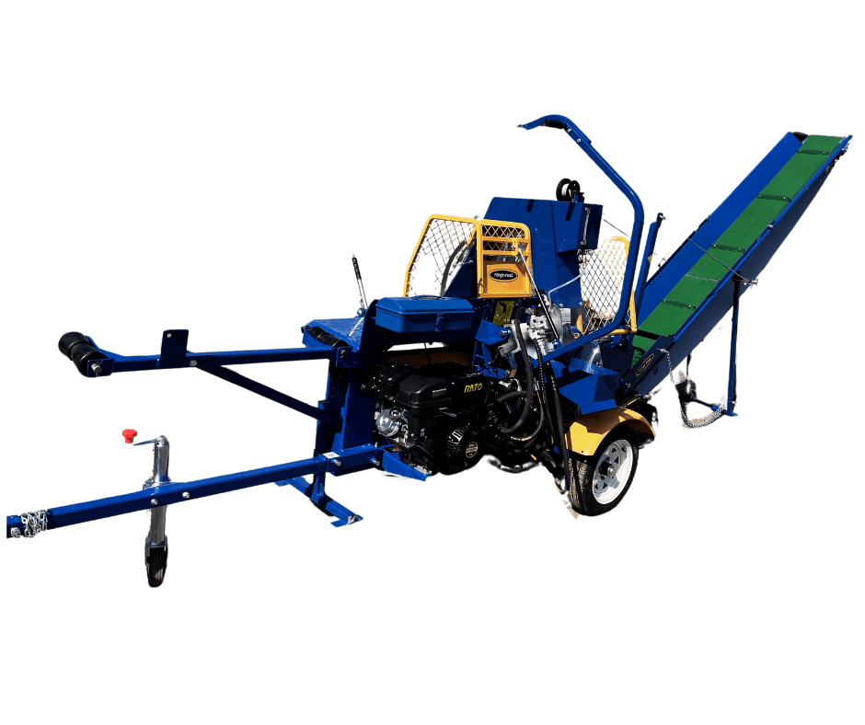
Firewood processor
EcoPro300-K Firewood Processor RR2503 Conveyor & Kohler (about $7100) - BackCountry Equipment
https://www.youtube.com/watch?v=RF4CY9ftTVo
Tajfun Firewood Processor ($69,000-$80,000 depending on size/features)

Slide 13
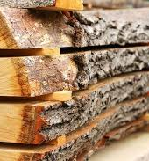
Sawmill adds value to the farm
Not all logs can go to the mill (short logs, “blued” logs, etc.)
Sawmill allows us to use our trees for projects in the home and on the farm.
Bandsaw mills have a fine kerf that reduces need for planing/sanding.
Custom milling brings another income stream.

Slide 14
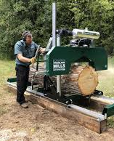
Bandsaw mill
Range Road 60 Series RR6026AW - BackCountry Equipment
https://www.youtube.com/watch?v=YC5eitdTz4c
Woodland Mills HM130MAX ($6,200)
Wood Mizer LT15START ($2900-$10,550 depending on size/features)

Slide 15
Next addition: Wood chipper
Why a wood chipper?
Reduces the need to burn slash.
Turns waste into a useful wood product for farm use or for sale.

Slide 16
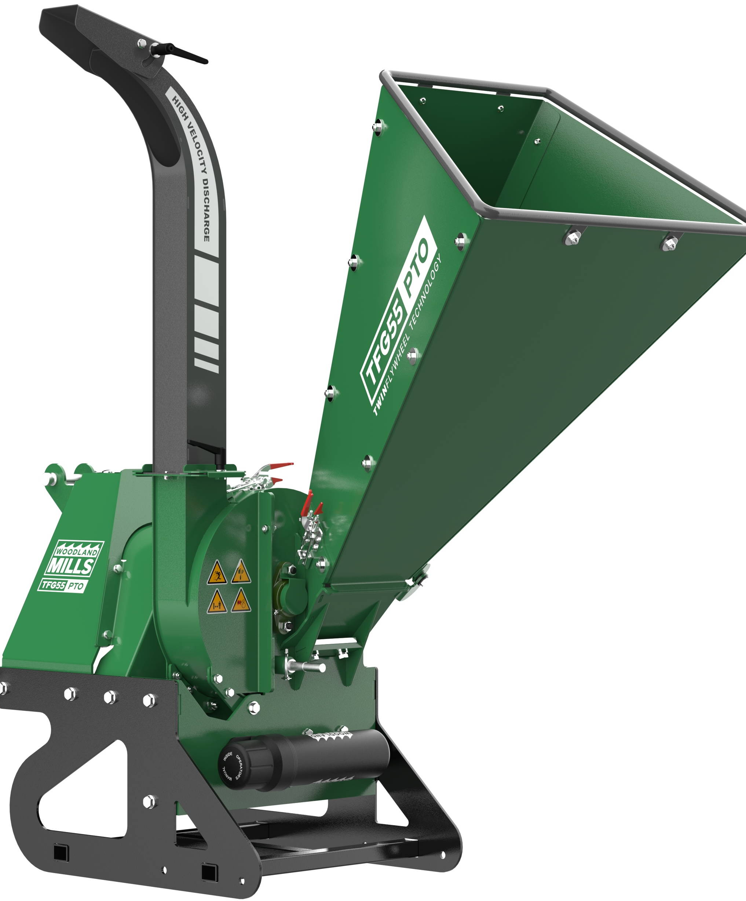
Wood chippers
Gas Powered:
Range Road Chippers ($2,000-$6,740 depending on size of wood chipped) – BackCountry Equipment
PTO Driven:
Woodland Mills ($2,000-$4,200 depending on size of wood chipped)
Woodmaxx ($2,900-$10,550 depending on size/features)

Slide 17
Conclusion
The manpower shortage in forestry affects us all, but we can do things to help ourselves.
It costs money to maintain the lawn and garden around your home, and it costs money to maintain your forest.
Unfortunately, trees are bigger than grass so it’s more expensive to maintain a forest.
The right tools can make forest management safer and easier.
Questions?

