Slide 1
What’s a Forest Management Plan and Why Do I Need One?
Eric Clippinger, Cf – Northwest management, inc.
Brooke Durnin – American Forest Management, Inc.

Slide 2
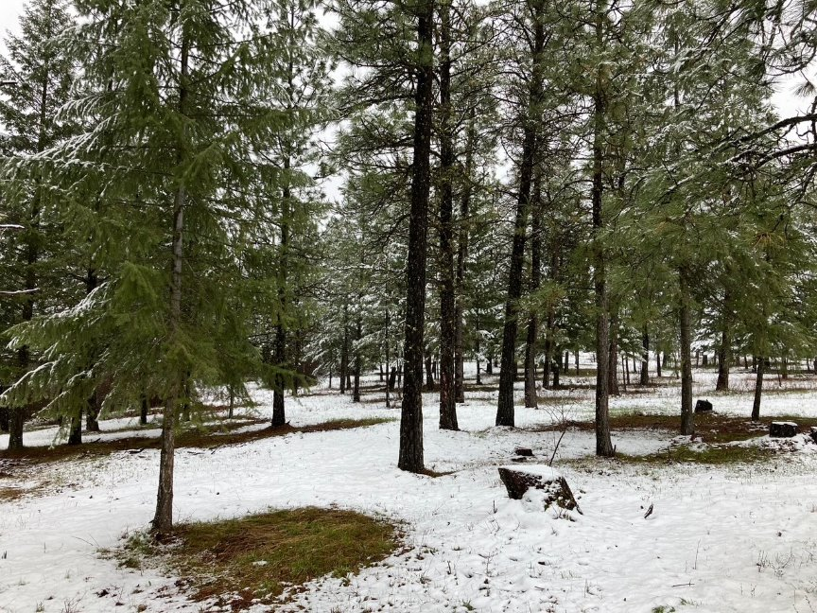
What is a Forest Management Plan (FMP)?
Management document tailored to a specific forest or ownership
All but the most basic plans should be customized to meet the needs, goals and objectives of the landowner
"Road map" or better yet a "workout plan"

Slide 3
Why Do I Need a Forest Management Plan?
Objective & designed
Tax purposes
Cost-share eligibility
Staying on track – should be updated every 10-15 years
Documentation
Legacy planning/posterity
Landowner and forestry club programs

Slide 4
Why Do I Need a Forest Management Plan?
Subjective & abstract
Help landowners better understand current forest conditions
Protect property from wildfire impacts
Provides a “road map” of management activities to meet landowners goals
Touches on a variety of learning styles -> visual, oral, hands on
Hope is not a management strategy or plan
Do your "work out" to reach your goals!

Slide 5
Basic Plan Elements
Landowner info & property history
Objective info on non-timber resources/topics -> hydrology, soil, access, wildlife
Current forest species, structure & condition
Recommended practices/activities & timelines
Information about cost-share programs

Slide 6
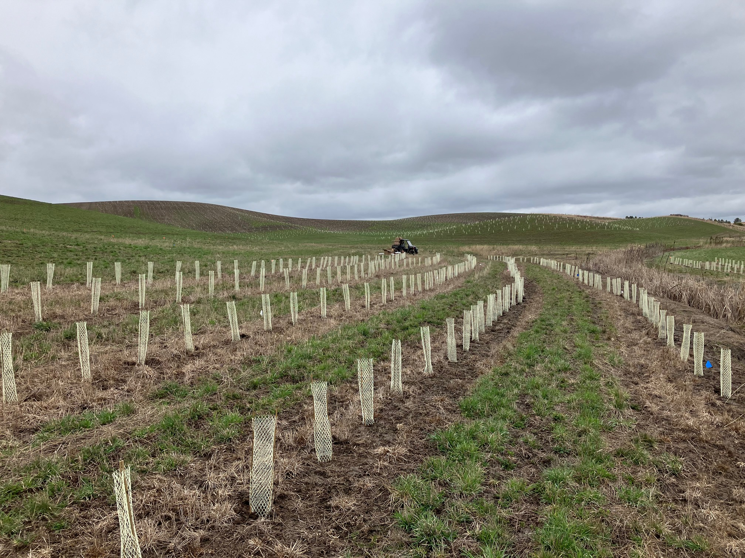
Types of FMPs
County Tax Plan
Tree Farm Management Plan
IDL/WA DNR Stewardship Plan
NRCS CAP 106

Slide 7
Tax Plans
Most basic type of plan – short & sweet
Rundown of current forestland metrics & general guidelines to keep forest stocked, healthy & growing
Required by county assessors/state tax commission to enroll or keep forests into forestland tax categories

Slide 8
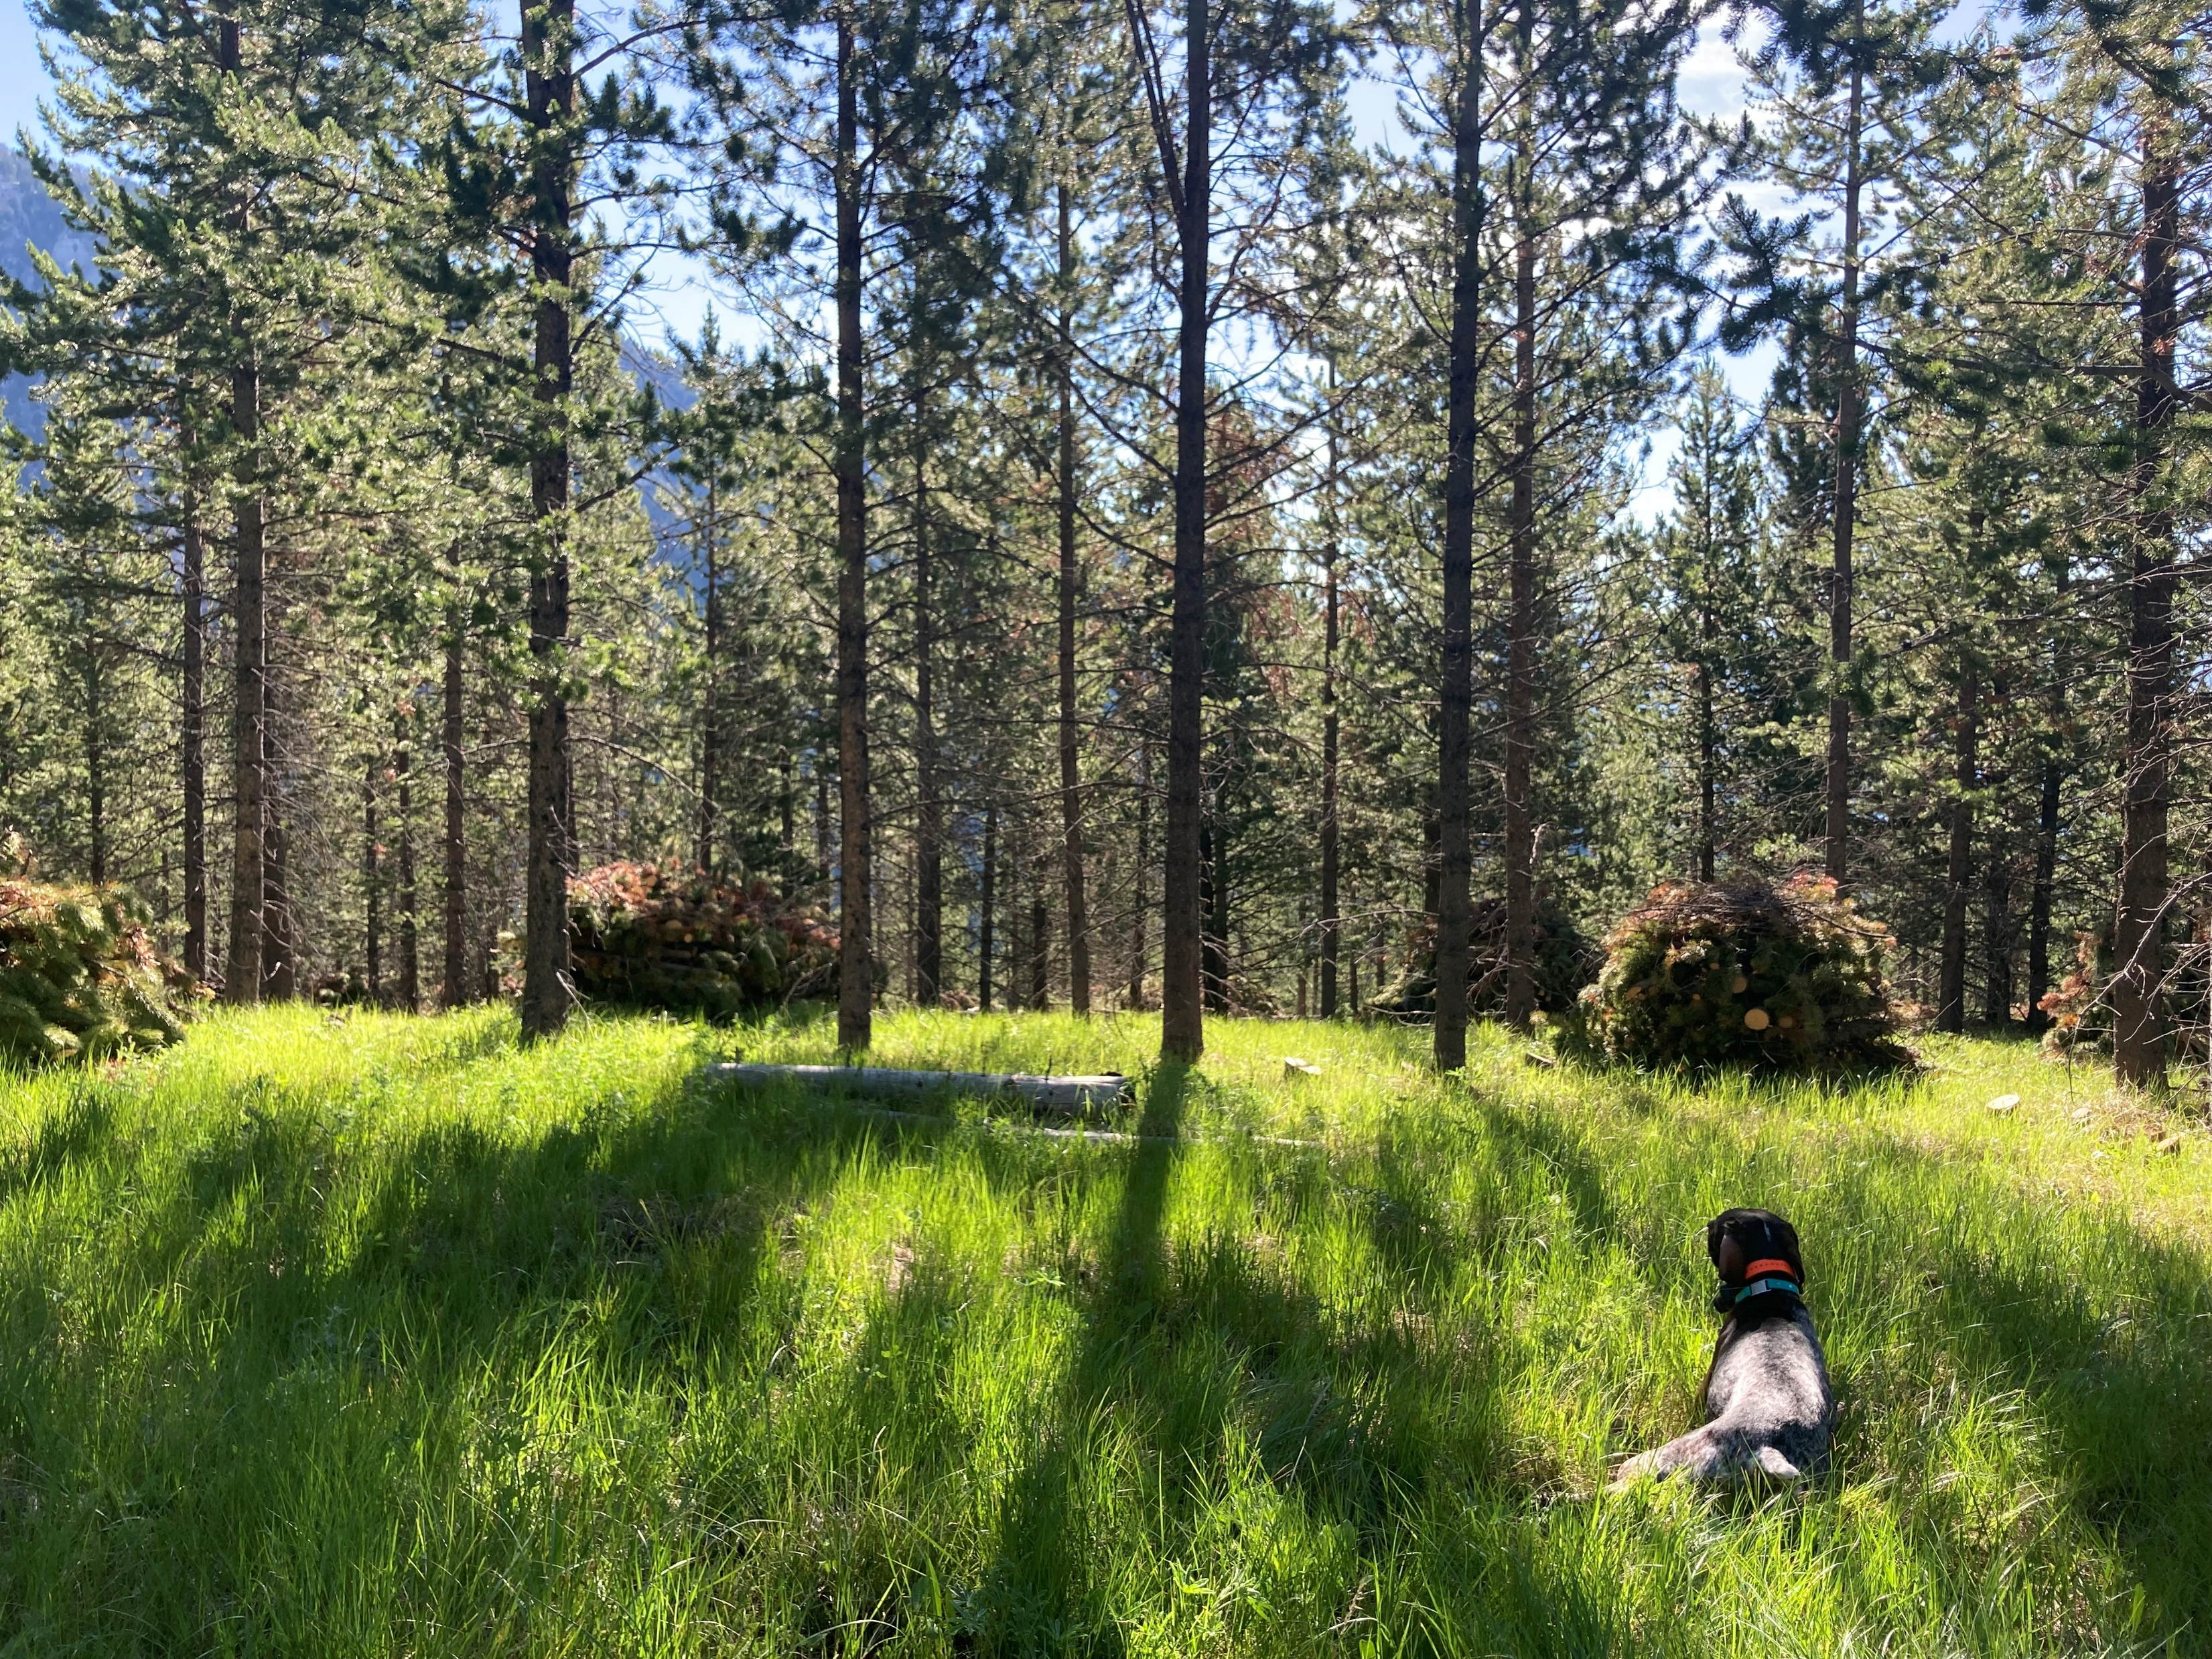
Conservation Planning Activity - CPA 106
NRCS specific forest management plan
Document objectives, resource concerns, makes practice recommendations.
Written by a Technical Service Provider (TSP)
Often a requirement to receive NRCS/EQIP Cost-share
Eligibility – FSA, AGI
Notes:
For EQIP, you need to be registered with Farm Service Agency, AGI form, etc.

Slide 9
Included in a CPA 106ning Activity - CPA 106
Recreation, aesthetic values and opportunities
Carbon sequestration and climate
Resource concerns
Legacy planning
Forest inventory
Forest practice recommendations
Practice schedule
Landowner goals and objectives
Forest history
Water resources
Soil resources
Topography
Access
Boundary lines
Cultural resources
Fish and wildlife habitat
Rare, threatened and endangered species

Slide 10
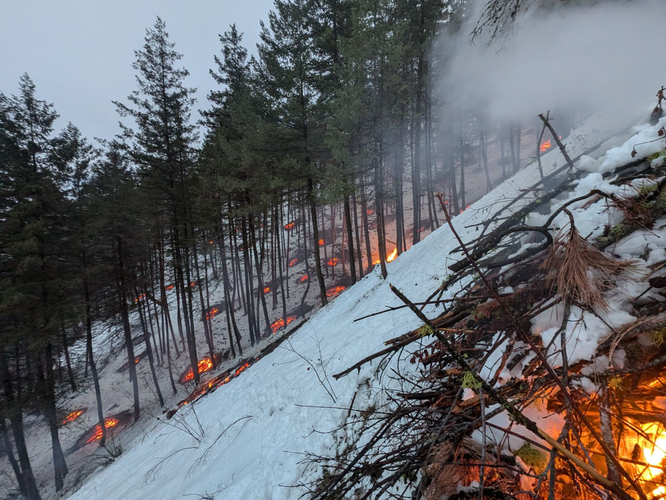
NRCS Forestry Practices
666 – Forest Stand Improvement
384 – Woody Residue Treatment
660 – Pruning
649 – Structures for Wildlife
612 – Tree and Shrub Establishment
490 – Site Preparation
383 – Fuel Break

Slide 11
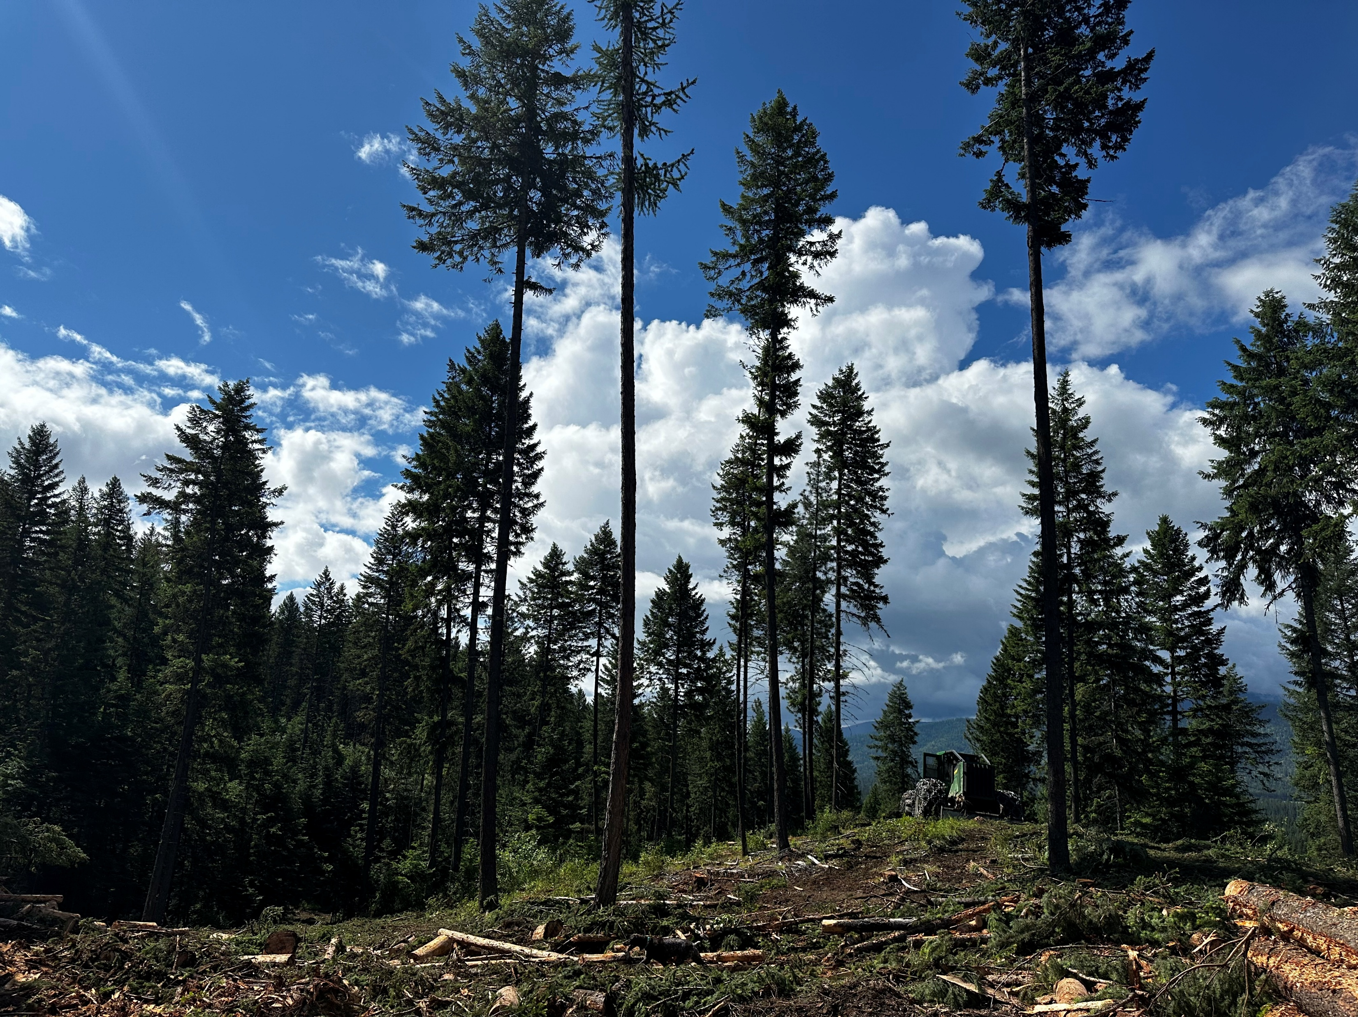
Forest Stewardship Plan
Administered by WA DNR
Qualify for financial assistance
Current use taxation
Recognition and certification programs
50 percent cost share may be available to hire a consulting forester
Eligibility – 5 or more acres
Notes:
Eligibility – 5 or more acres

Slide 12
Washington Integrated Forest Management Plan Guidelines Idaho One Plan Guidelines

Slide 13
Any questions?? Thank you for your time!!
Brooke Durnin
American Forest Management, Inc.
406-250-5416
Brooke.Durnin@AFMForest.com
Eric Clippinger
Northwest Management, Inc.
208-883-4488
Clip@northwestmanagement.com

